Slide 1

Notes:
Hello everyone, I’m Giorgos. I work as a software engineer, and whenever I sit down to write new tests, I run into the same questions: Should I mock here or not? And if I do, which kind of test double is the right fit? To answer that, let’s start at the beginning: what exactly is a test double?

Slide 2
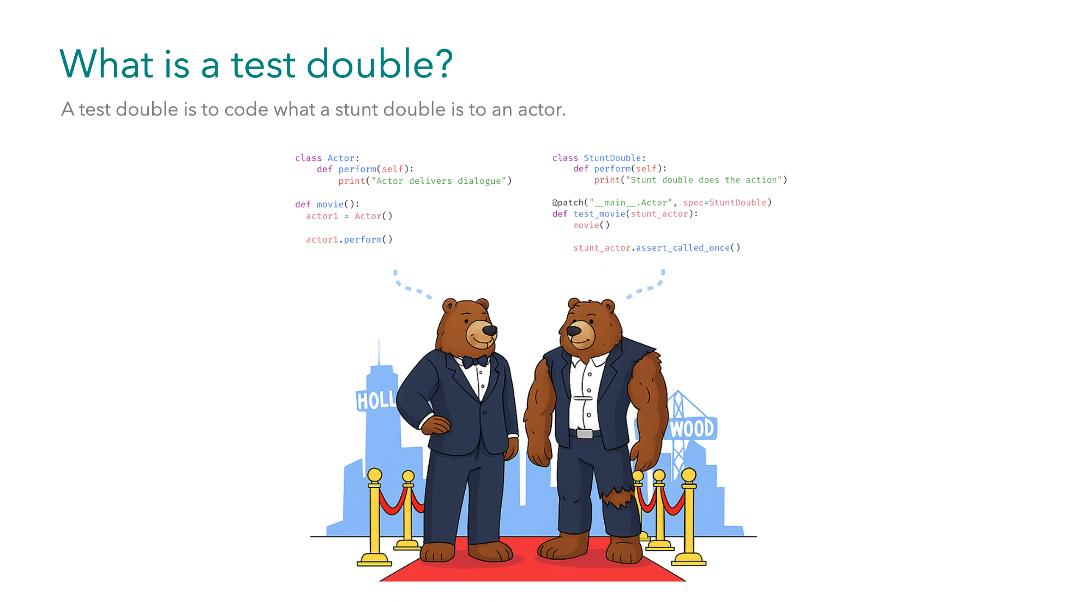
Notes:
Just like actors don’t perform every dangerous scene by themselves and stunt doubles step in for them, instead. Okay maybe that's not true for Tom Cruise, he does his own stunts. In the same way, we use test doubles in place of real objects. They take the risks for us — making our tests faster, safer, and more predictable. Without them, our tests get tied to real services and environments, and that’s when things become slow and flaky.

Slide 3

Notes:
Having said that, let's take a look at the different types of test doubles. We have... All of them can replace objects in our code, but each one serves a different purpose. And in fact they can be used together as well.

Slide 4

Notes:
Having said that, let's take a look at the different types of test doubles. We have... All of them can replace objects in our code, but each one serves a different purpose. And in fact they can be used together as well.

Slide 5
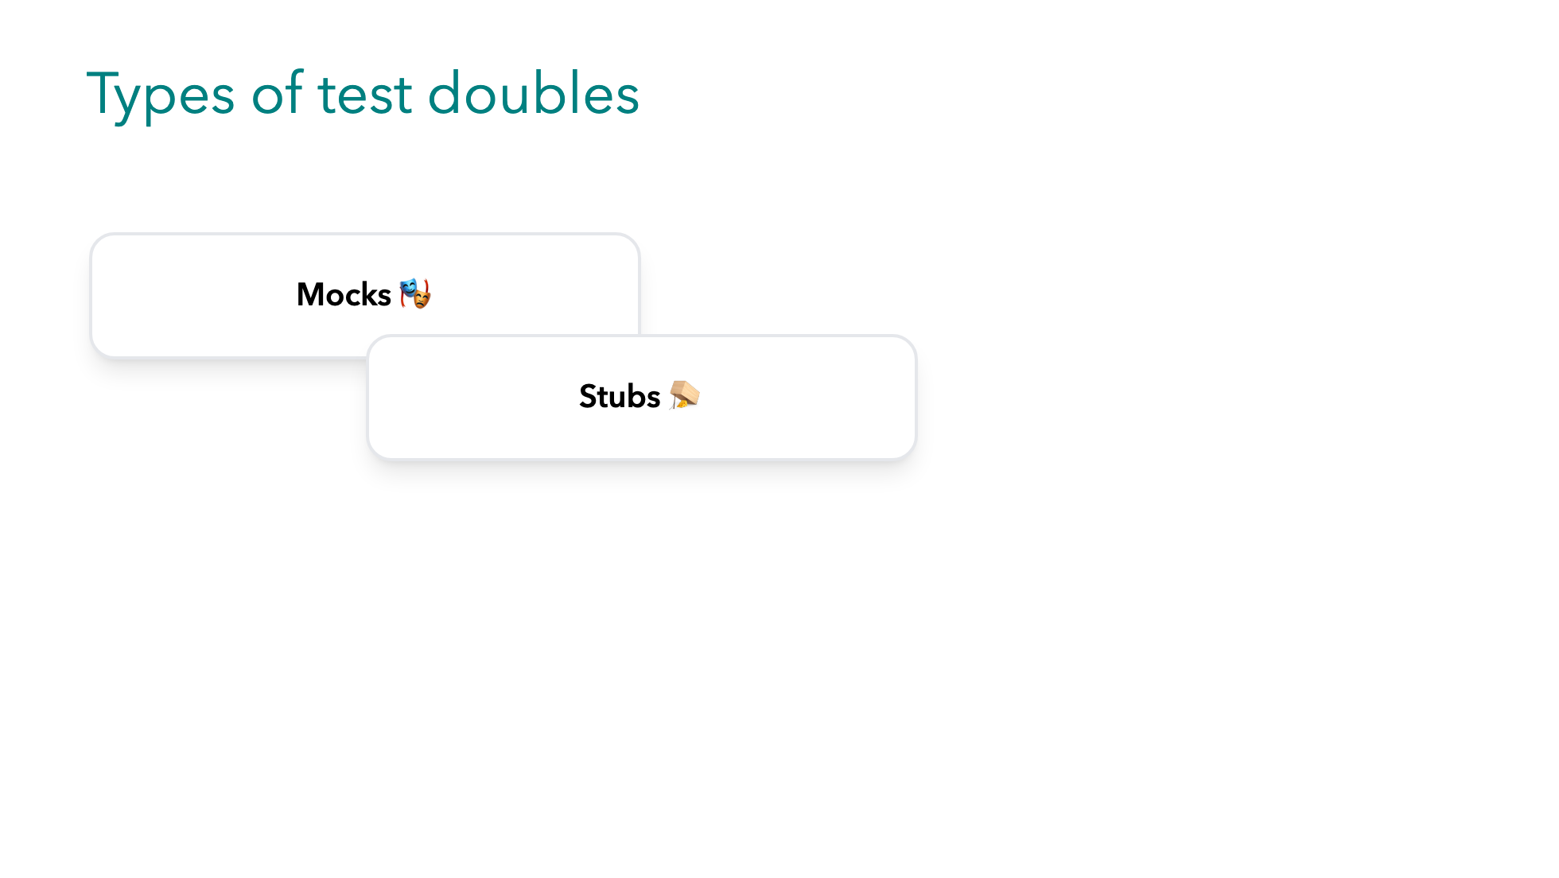
Notes:
Having said that, let's take a look at the different types of test doubles. We have... All of them can replace objects in our code, but each one serves a different purpose. And in fact they can be used together as well.

Slide 6
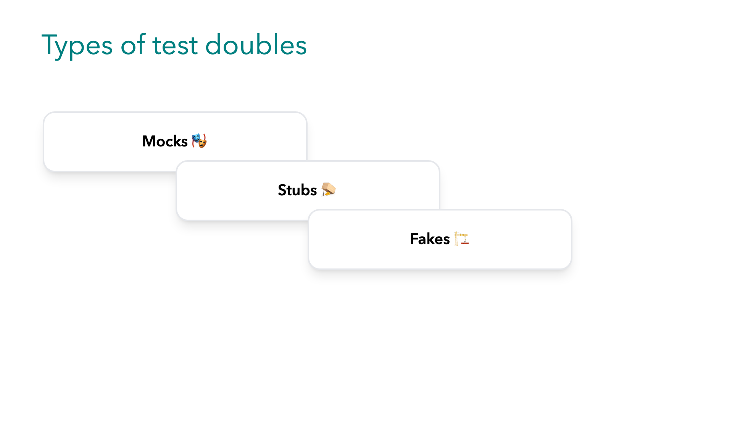
Notes:
Having said that, let's take a look at the different types of test doubles. We have... All of them can replace objects in our code, but each one serves a different purpose. And in fact they can be used together as well.

Slide 7
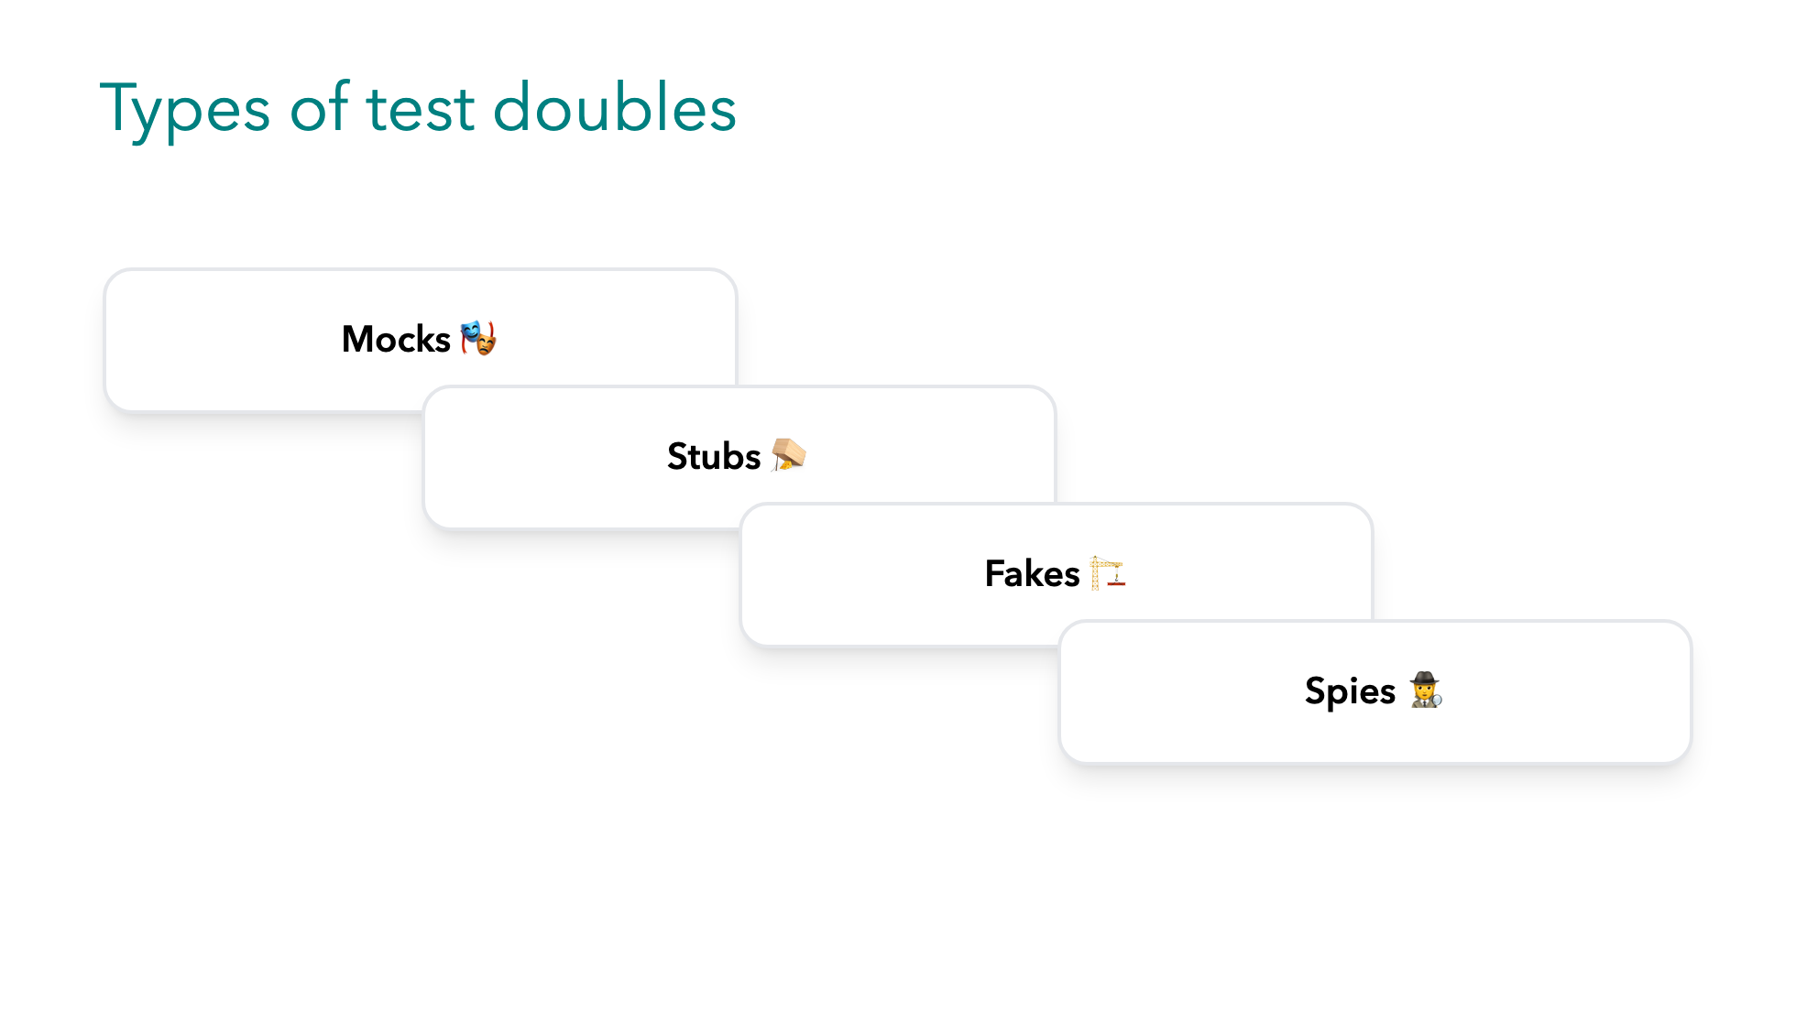
Notes:
Having said that, let's take a look at the different types of test doubles. We have... All of them can replace objects in our code, but each one serves a different purpose. And in fact they can be used together as well.

Slide 8
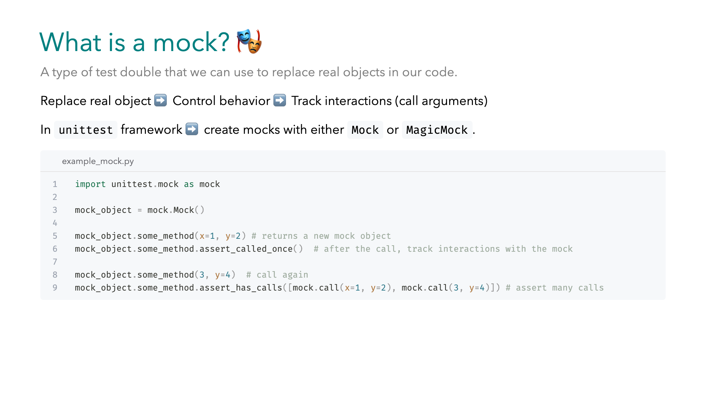
Notes:
A mock is a type of `test_double` that stands in place for real objects in our code. It replaces the original object with one that we can control the behavior of, and allows us to track the interactions with the mocked object. In Python's built-in test framework there are two foundational classes that create mocks, `Mock` & `MagicMock`. -- Now let's have a look at some features of the `Mock` class. We can call any method with any arguments, and the method exists automatically. While the return value will be a new mock. If we call the same method again, we can assert all of them at once. Just be consistent -- in mixing arguments...with keyword arguments in call assertions. You have to assert them the way they were called, in the exact order.

Slide 9
Notes:
A mock is a type of `test_double` that stands in place for real objects in our code. It replaces the original object with one that we can control the behavior of, and allows us to track the interactions with the mocked object. In Python's built-in test framework there are two foundational classes that create mocks, `Mock` & `MagicMock`. -- Now let's have a look at some features of the `Mock` class. We can call any method with any arguments, and the method exists automatically. While the return value will be a new mock. If we call the same method again, we can assert all of them at once. Just be consistent -- in mixing arguments...with keyword arguments in call assertions. You have to assert them the way they were called, in the exact order.

Slide 10
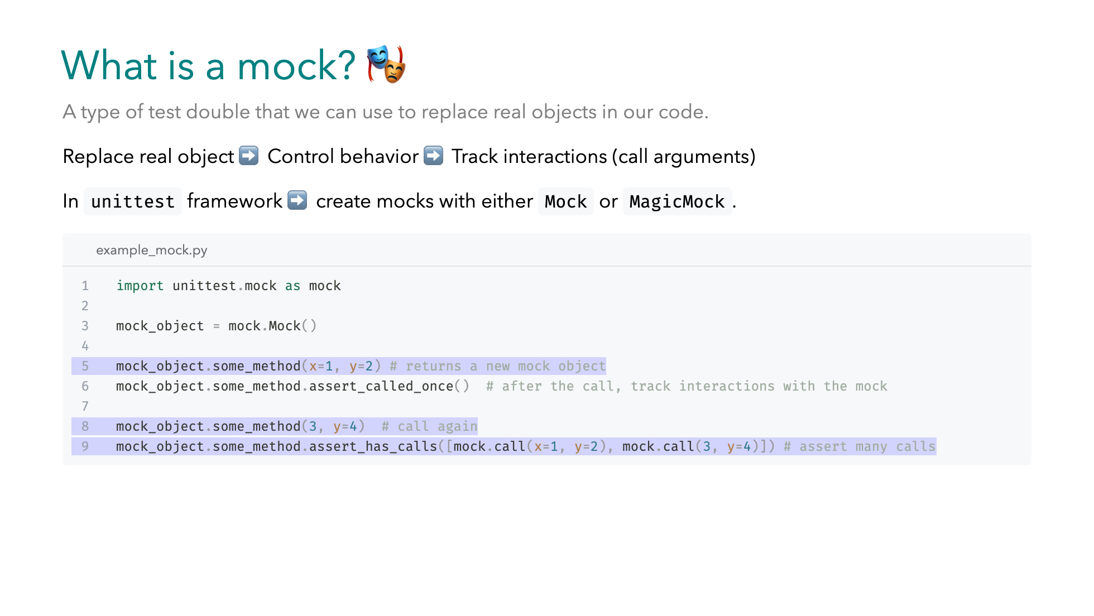
Notes:
A mock is a type of `test_double` that stands in place for real objects in our code. It replaces the original object with one that we can control the behavior of, and allows us to track the interactions with the mocked object. In Python's built-in test framework there are two foundational classes that create mocks, `Mock` & `MagicMock`. -- Now let's have a look at some features of the `Mock` class. We can call any method with any arguments, and the method exists automatically. While the return value will be a new mock. If we call the same method again, we can assert all of them at once. Just be consistent -- in mixing arguments...with keyword arguments in call assertions. You have to assert them the way they were called, in the exact order.

Slide 11
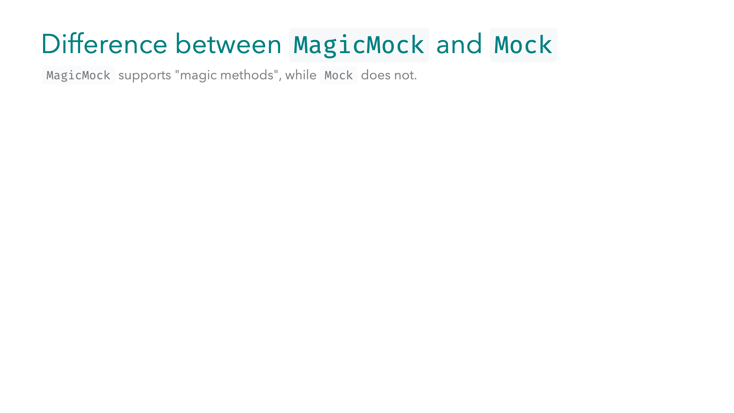
Notes:
What is the difference between the two though? `MagicMock` supports magic methods . -- Let's see an example, suppose we want to use the object in a `with` block. In order to do that our object needs to define the context manager protocol, this means it needs to define `__enter__` & `__exit__` , which are magic methods. However, `Mock` objects do not do this automatically! As we can see in the right column our snippet fails with a `TypeError`. We have to use a `MagicMock` if we are going to call magic methods in the code we are replacing. And this is not limited to `with` blocks, it might as well be other special methods like `length`, should the object we are replacing behave like a `Sequence`, a list or a tuple.

Slide 12
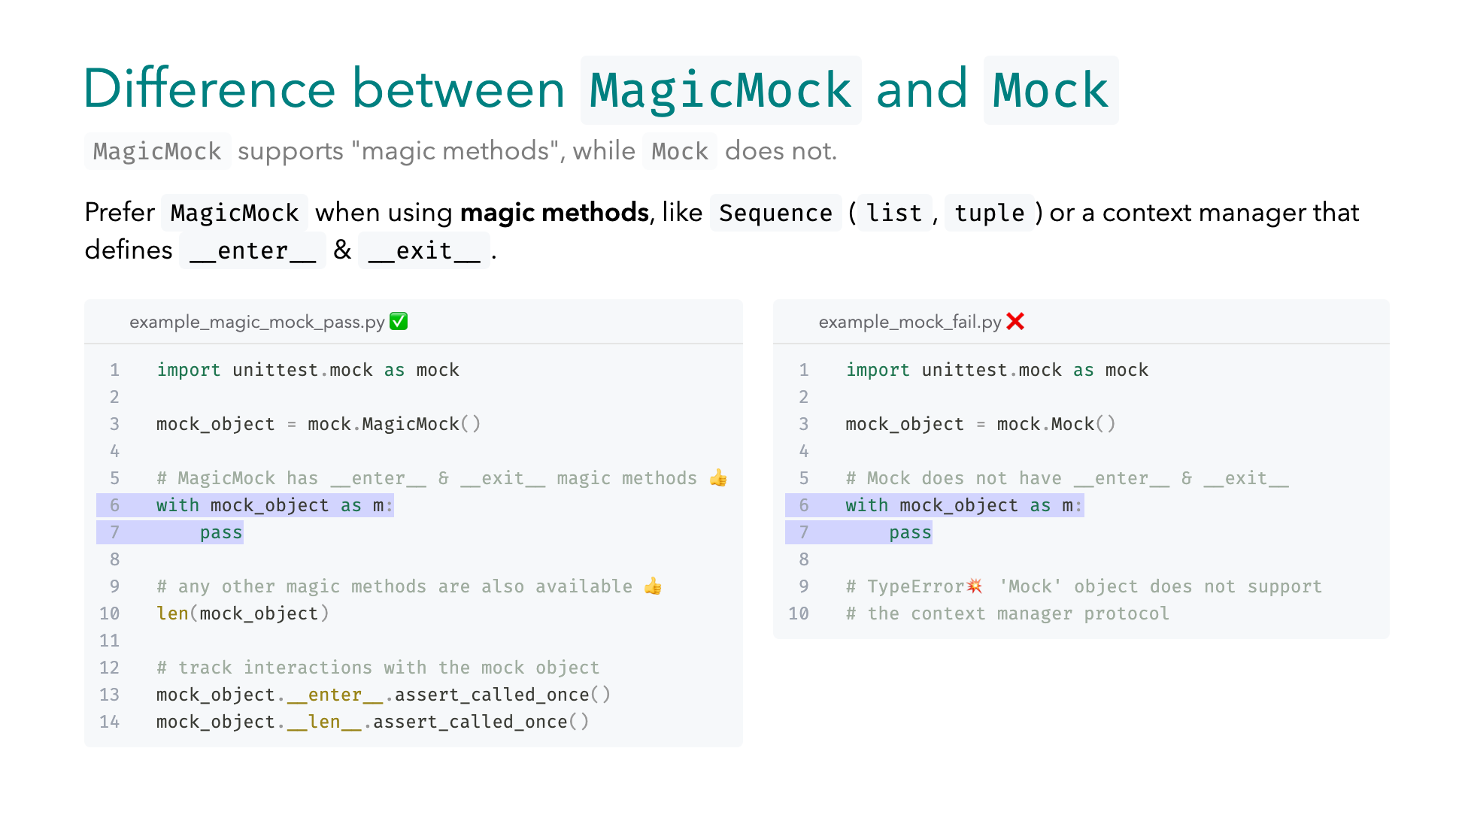
Notes:
What is the difference between the two though? `MagicMock` supports magic methods . -- Let's see an example, suppose we want to use the object in a `with` block. In order to do that our object needs to define the context manager protocol, this means it needs to define `__enter__` & `__exit__` , which are magic methods. However, `Mock` objects do not do this automatically! As we can see in the right column our snippet fails with a `TypeError`. We have to use a `MagicMock` if we are going to call magic methods in the code we are replacing. And this is not limited to `with` blocks, it might as well be other special methods like `length`, should the object we are replacing behave like a `Sequence`, a list or a tuple.

Slide 13
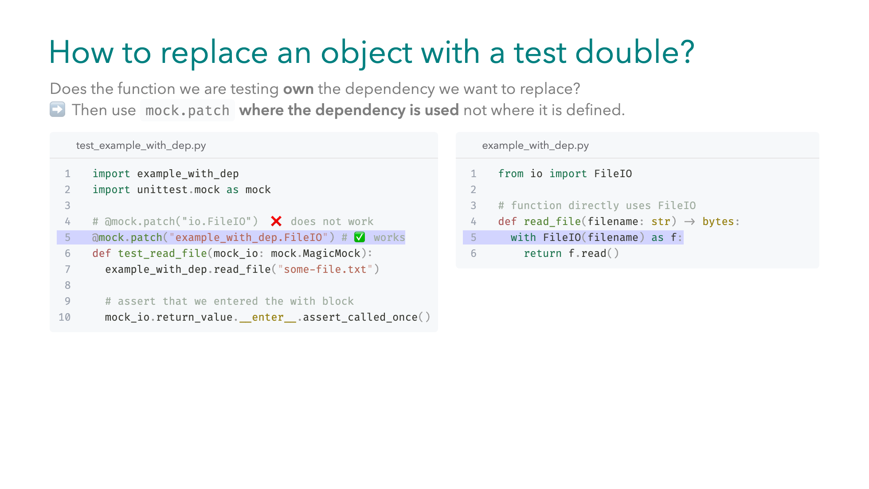
Notes:
But how to actually replace the real object with a test double? In the case of a function that owns the dependency, we need to use `mock.patch` and patch the imported name where the dependency is being used. For example `read_file` owns the `FileIO` dependency, and it is responsible for opening & closing it before reading from it. In the left column we patch it, and by default `mock.patch`, replaces the object with a `MagicMock`. But you can provide your own mock object with the `new` argument. -- Note that patching globally at the place `FileIO` is defined does not work. Why is that though? [bullets] -- Well, when we import FileIO from io module, inside our example module we bind a local reference to the name `FileIO`. Secondly, our patch targets the global `FileIO` name, but read_file uses the local reference already, so it won't capture our patch. To fix that we would have to do lazy importing, which would have called our patch before importing our example module. Or we would have to reload explicitly, both of them are not a good practice.

Slide 14
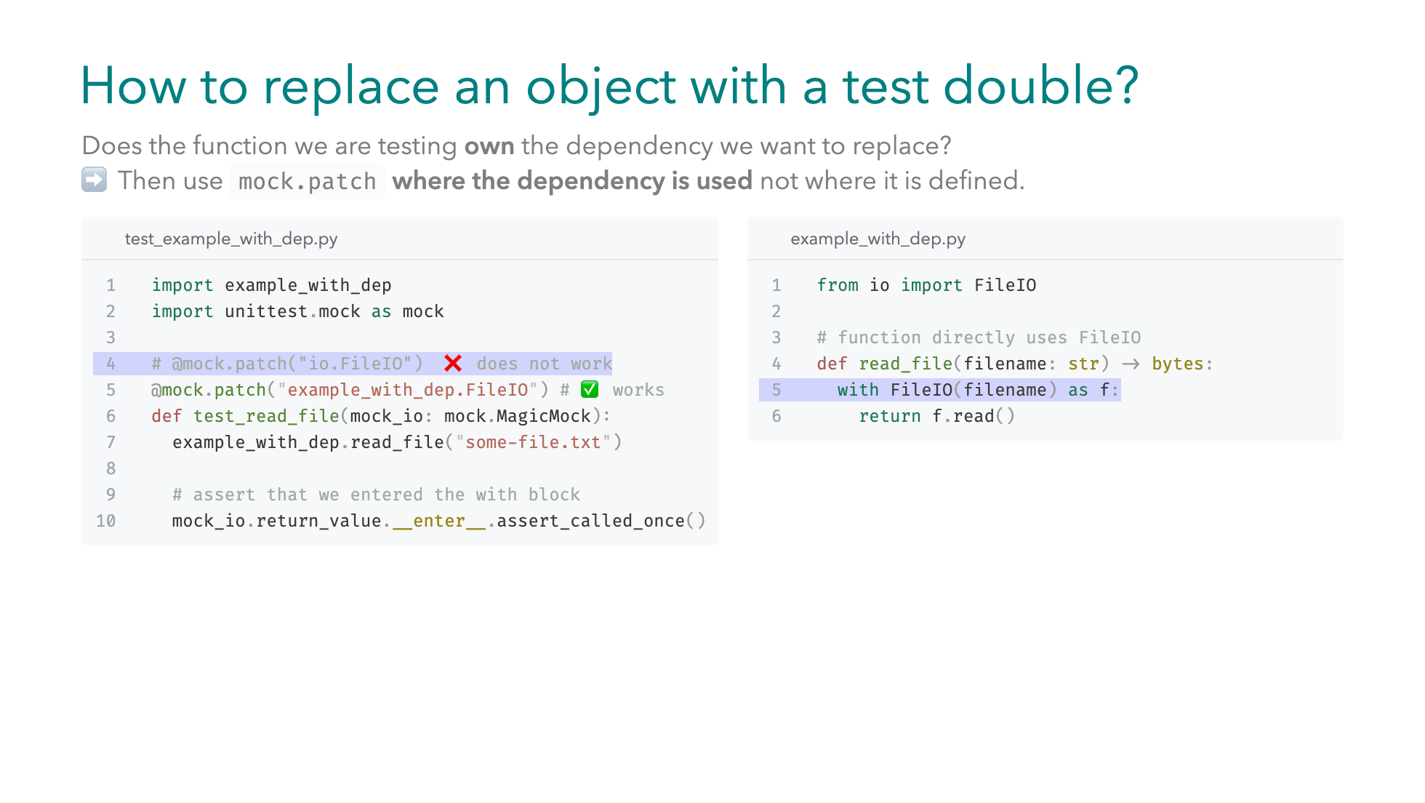
Notes:
But how to actually replace the real object with a test double? In the case of a function that owns the dependency, we need to use `mock.patch` and patch the imported name where the dependency is being used. For example `read_file` owns the `FileIO` dependency, and it is responsible for opening & closing it before reading from it. In the left column we patch it, and by default `mock.patch`, replaces the object with a `MagicMock`. But you can provide your own mock object with the `new` argument. -- Note that patching globally at the place `FileIO` is defined does not work. Why is that though? [bullets] -- Well, when we import FileIO from io module, inside our example module we bind a local reference to the name `FileIO`. Secondly, our patch targets the global `FileIO` name, but read_file uses the local reference already, so it won't capture our patch. To fix that we would have to do lazy importing, which would have called our patch before importing our example module. Or we would have to reload explicitly, both of them are not a good practice.

Slide 15
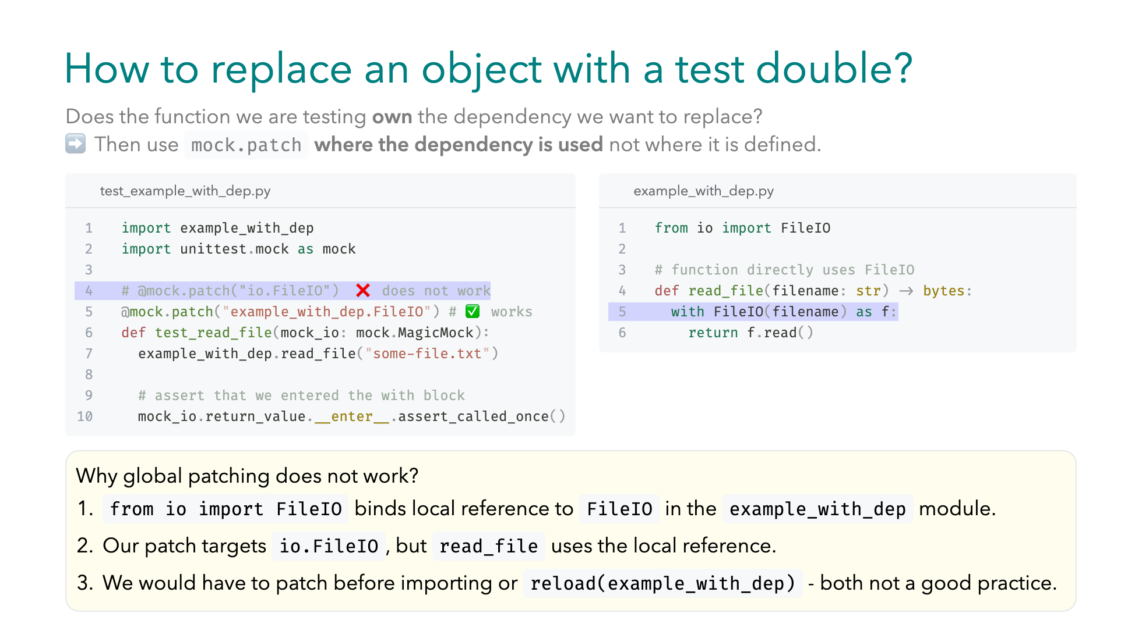
Notes:
But how to actually replace the real object with a test double? In the case of a function that owns the dependency, we need to use `mock.patch` and patch the imported name where the dependency is being used. For example `read_file` owns the `FileIO` dependency, and it is responsible for opening & closing it before reading from it. In the left column we patch it, and by default `mock.patch`, replaces the object with a `MagicMock`. But you can provide your own mock object with the `new` argument. -- Note that patching globally at the place `FileIO` is defined does not work. Why is that though? [bullets] -- Well, when we import FileIO from io module, inside our example module we bind a local reference to the name `FileIO`. Secondly, our patch targets the global `FileIO` name, but read_file uses the local reference already, so it won't capture our patch. To fix that we would have to do lazy importing, which would have called our patch before importing our example module. Or we would have to reload explicitly, both of them are not a good practice.

Slide 16
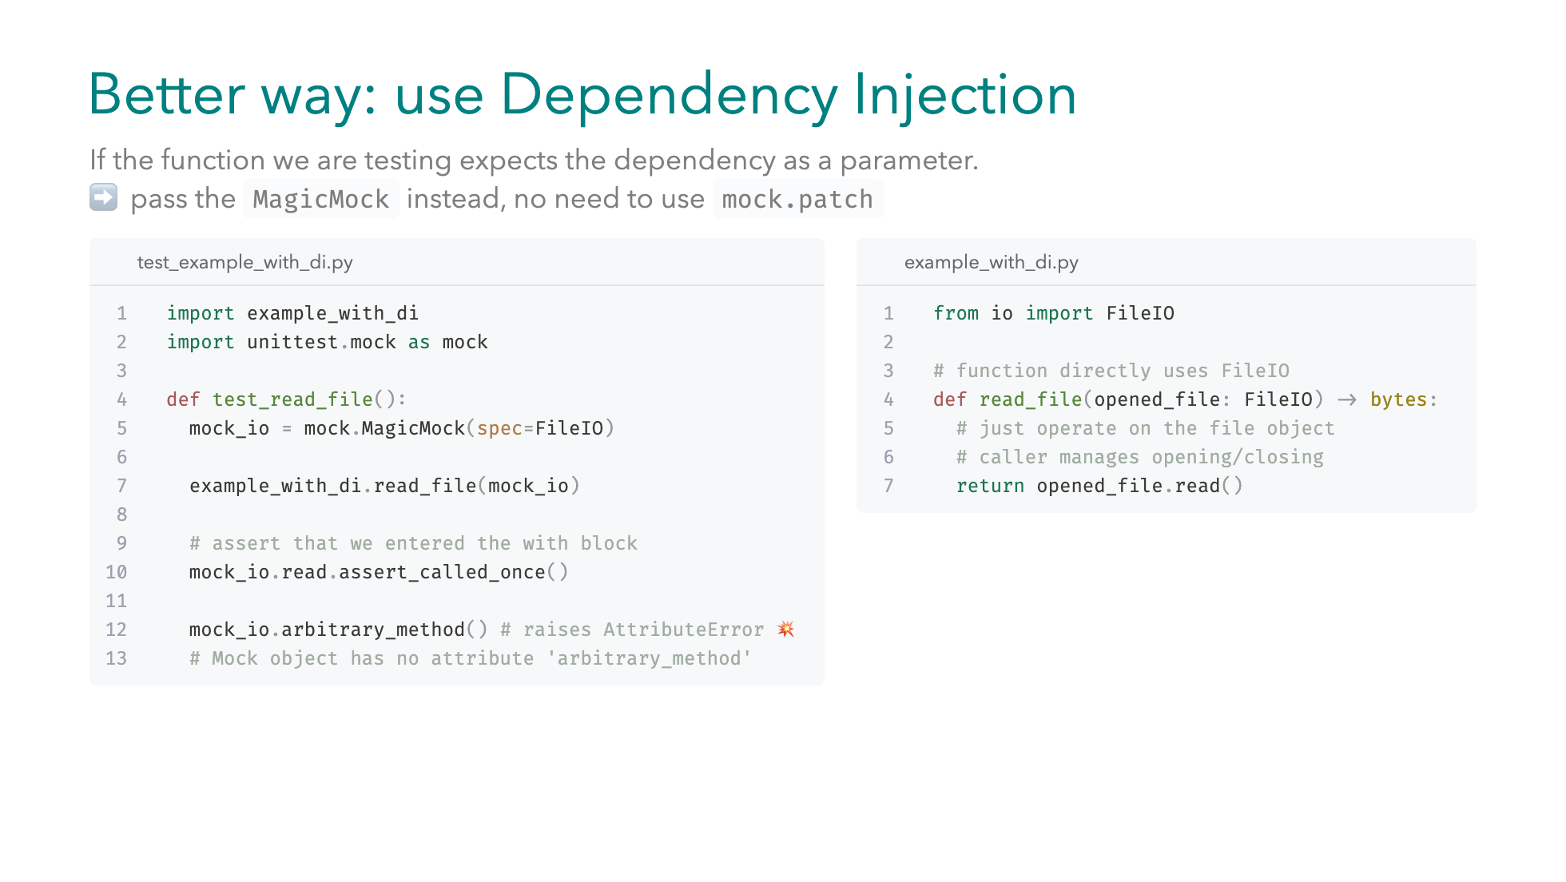
Notes:
In what other ways can we replace a dependency? In this example, we call read_file. The implementation simply returns the contents of the already opened file. Notice that read_file does not own the FileIO object, it just operates on it. When a function accepts its dependency as a parameter, there’s no need to patch. Instead, pass a mock object in place of the dependency. -- In the test, we create a MagicMock with a spec argument. The spec makes the mock strictly follow the protocol of the FileIO class. That’s why calling an arbitrary method on it raises an AttributeError. The mock only allows real FileIO methods.

Slide 17
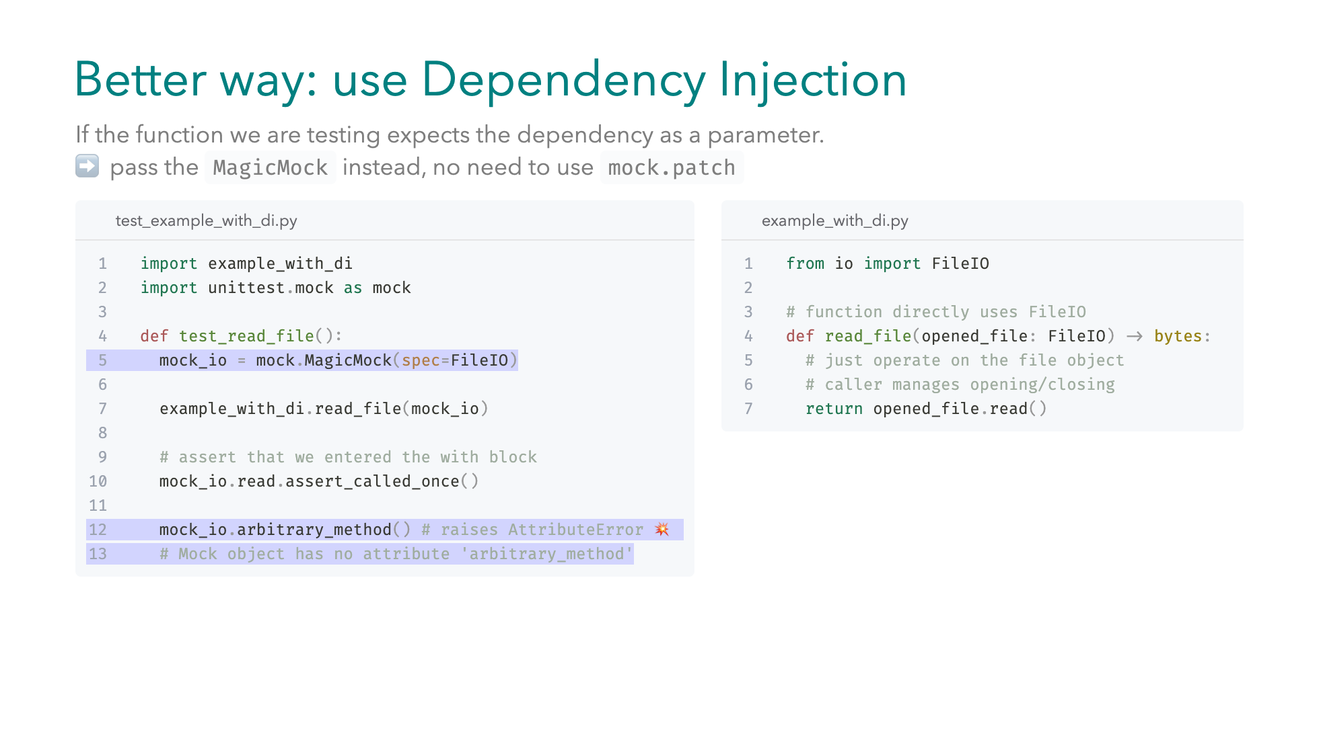
Notes:
In what other ways can we replace a dependency? In this example, we call read_file. The implementation simply returns the contents of the already opened file. Notice that read_file does not own the FileIO object, it just operates on it. When a function accepts its dependency as a parameter, there’s no need to patch. Instead, pass a mock object in place of the dependency. -- In the test, we create a MagicMock with a spec argument. The spec makes the mock strictly follow the protocol of the FileIO class. That’s why calling an arbitrary method on it raises an AttributeError. The mock only allows real FileIO methods.

Slide 18
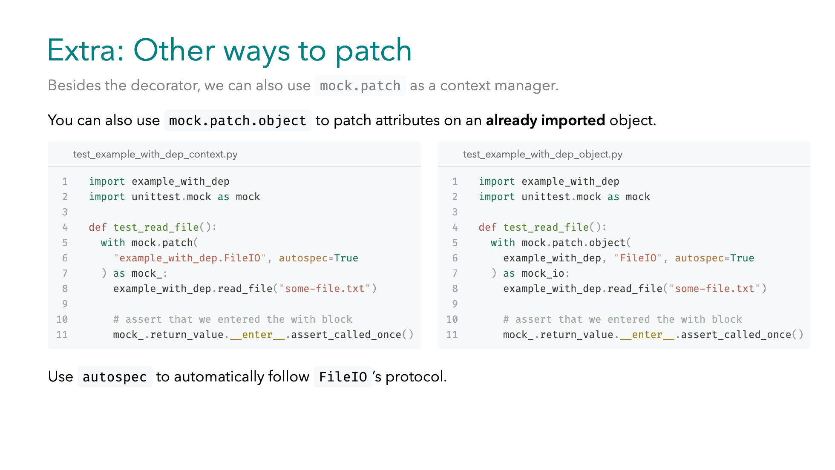
Notes:
If we can’t inject, we patch as we saw earlier. -- Besides decorators, we can use `patch` as context manager. -- `patch.object` is also handy when the module is already imported, and we patch its attributes directly. Just like the decorator lives for the duration of the wrapped function's scope. The patch lives for the scope of the `with block`. We can use the `autospec` flag to have the mock automatically deduce which protocol to follow.

Slide 19
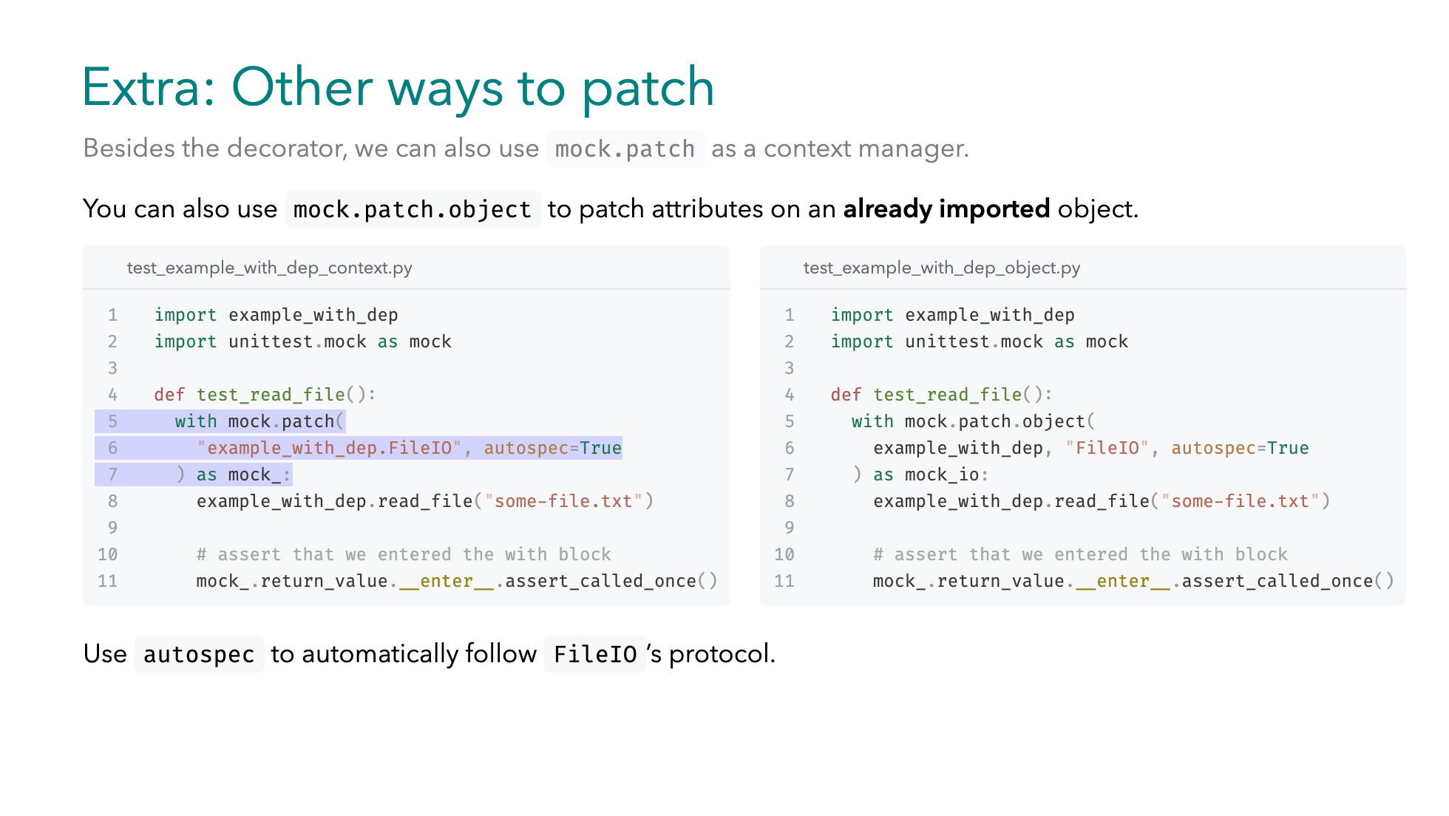
Notes:
If we can’t inject, we patch as we saw earlier. -- Besides decorators, we can use `patch` as context manager. -- `patch.object` is also handy when the module is already imported, and we patch its attributes directly. Just like the decorator lives for the duration of the wrapped function's scope. The patch lives for the scope of the `with block`. We can use the `autospec` flag to have the mock automatically deduce which protocol to follow.

Slide 20
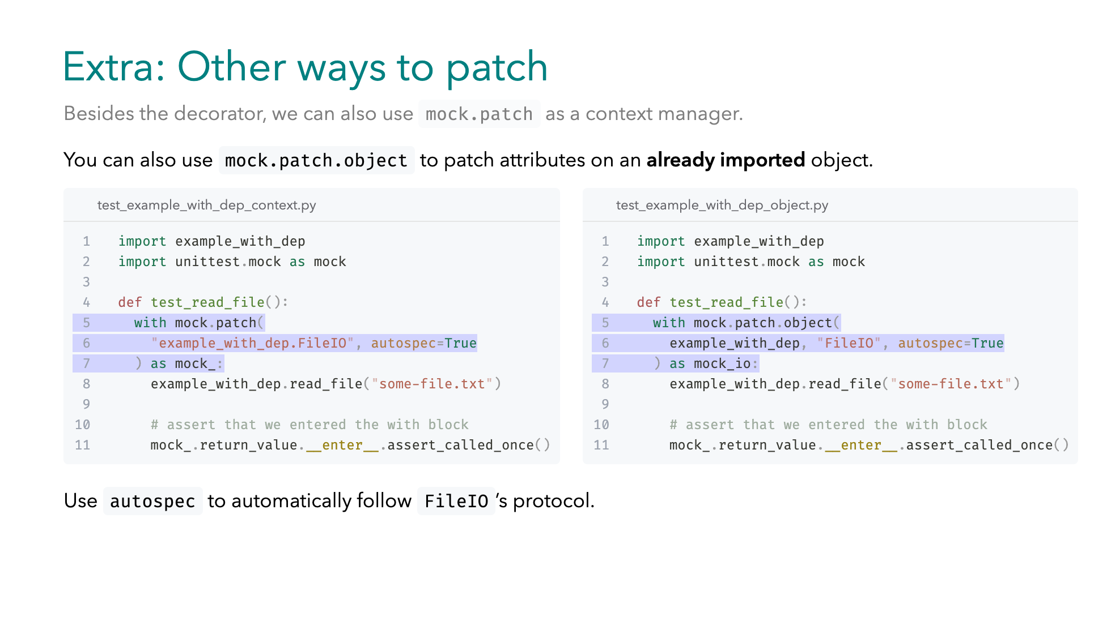
Notes:
If we can’t inject, we patch as we saw earlier. -- Besides decorators, we can use `patch` as context manager. -- `patch.object` is also handy when the module is already imported, and we patch its attributes directly. Just like the decorator lives for the duration of the wrapped function's scope. The patch lives for the scope of the `with block`. We can use the `autospec` flag to have the mock automatically deduce which protocol to follow.

Slide 21
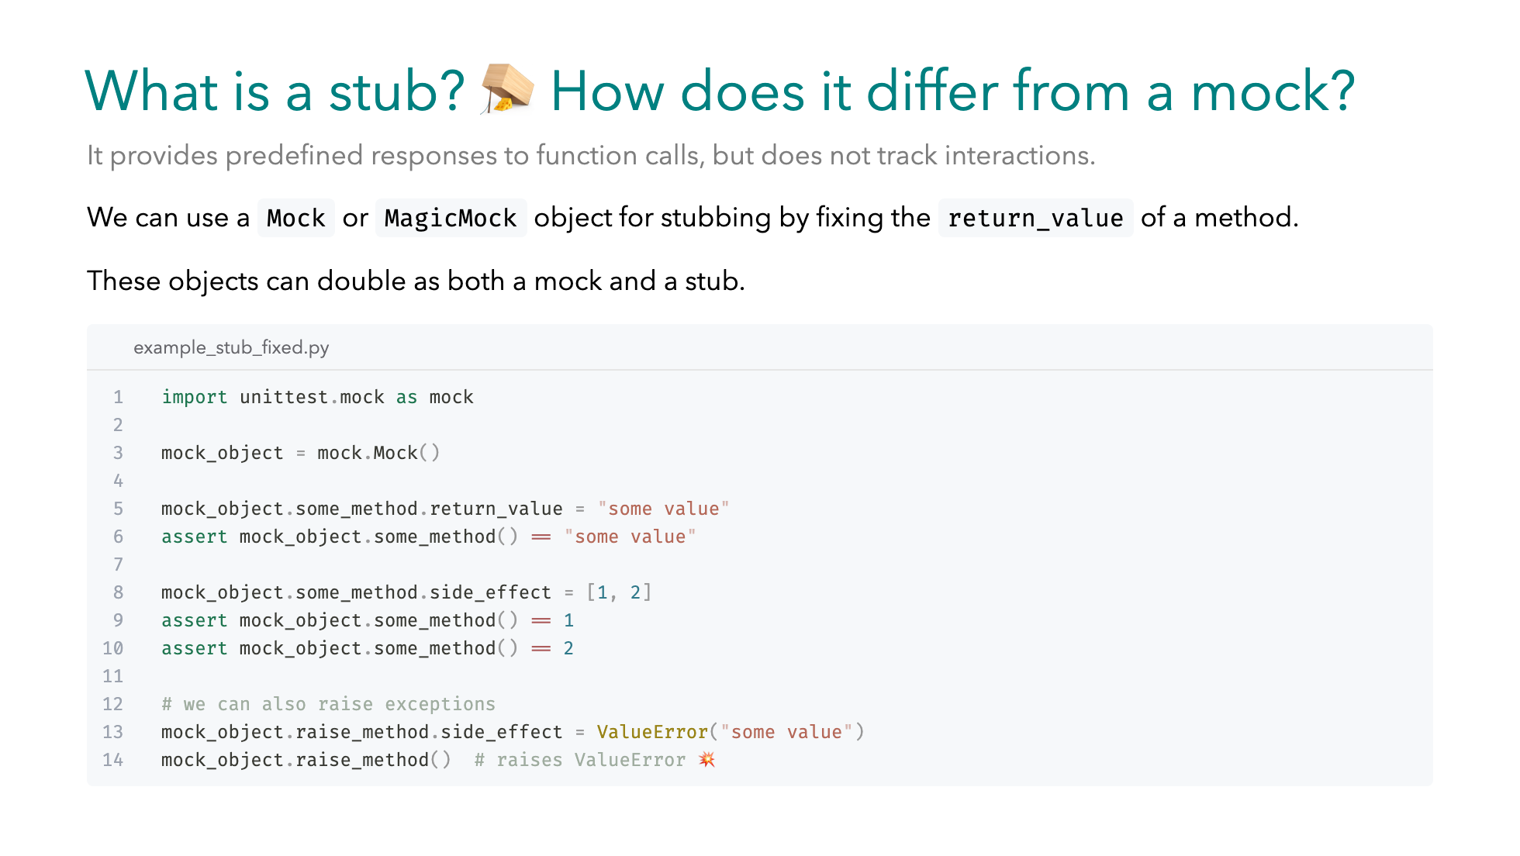
Notes:
As of now we have covered mocks but what is a stub, how does it differ? `Stubs` provide canned responses, helping us test outputs or control intermediate results. `Mock` & `MagicMock`, the usual suspects...can be used to provide these results...for functions that we expect to be called in our unit. In our example this function is called `some_method` -- One way to set fixed responses is to set the `return_value`, this way every call will always return `some_value` -- In the case of repeated calls with different return values we can provide an iterable to the `side_effect` attribute -- Finally, to test against errors we can use `side_effect` to raise Exceptions like a `ValueError`

Slide 22
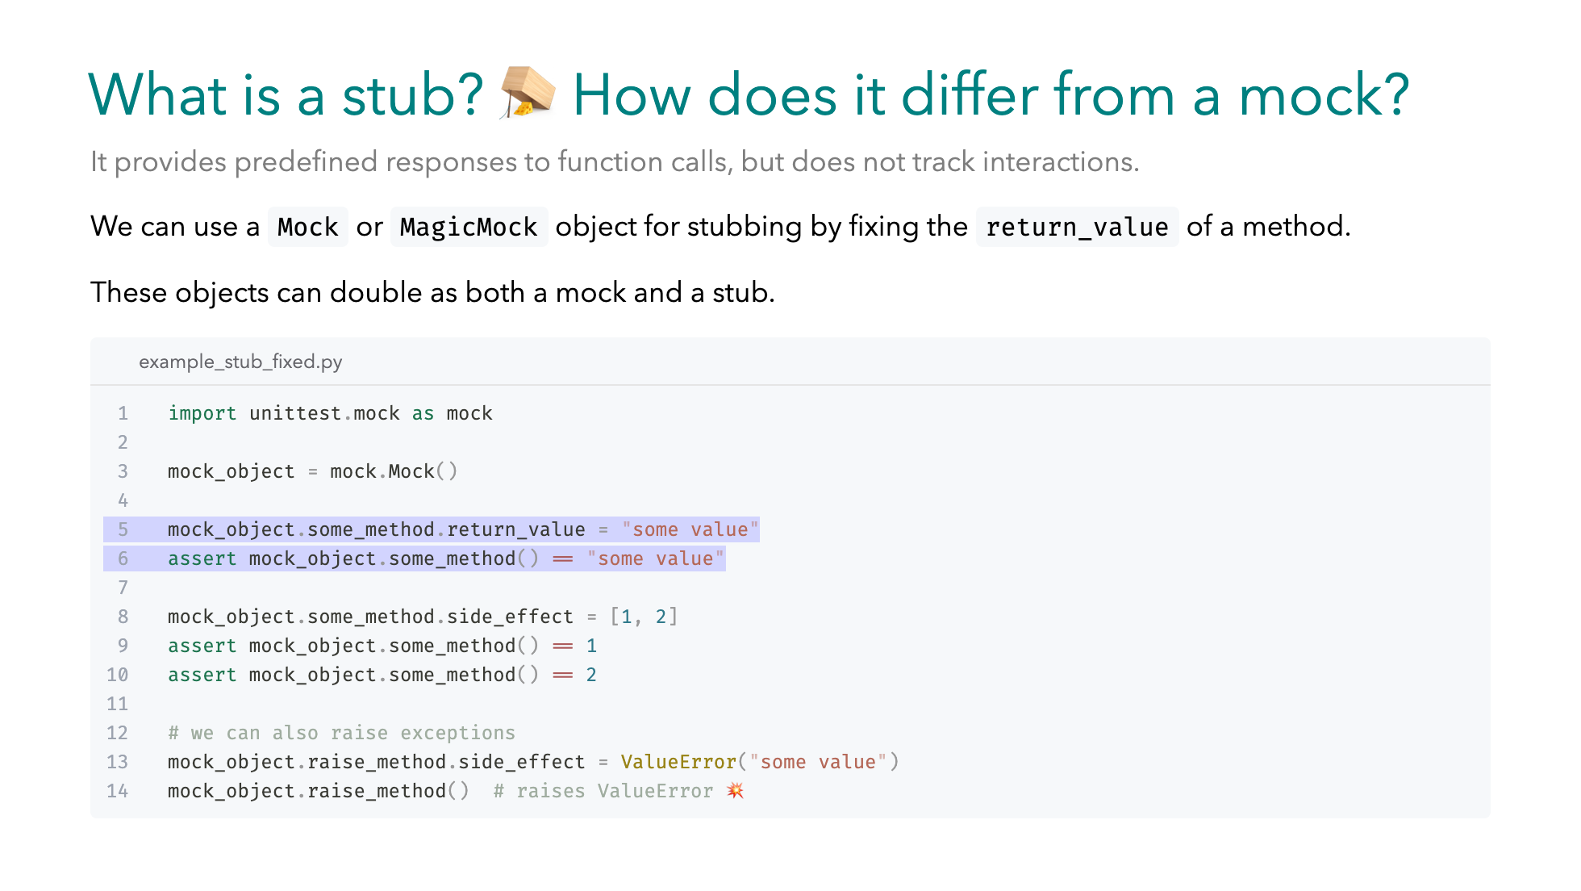
Notes:
As of now we have covered mocks but what is a stub, how does it differ? `Stubs` provide canned responses, helping us test outputs or control intermediate results. `Mock` & `MagicMock`, the usual suspects...can be used to provide these results...for functions that we expect to be called in our unit. In our example this function is called `some_method` -- One way to set fixed responses is to set the `return_value`, this way every call will always return `some_value` -- In the case of repeated calls with different return values we can provide an iterable to the `side_effect` attribute -- Finally, to test against errors we can use `side_effect` to raise Exceptions like a `ValueError`

Slide 23
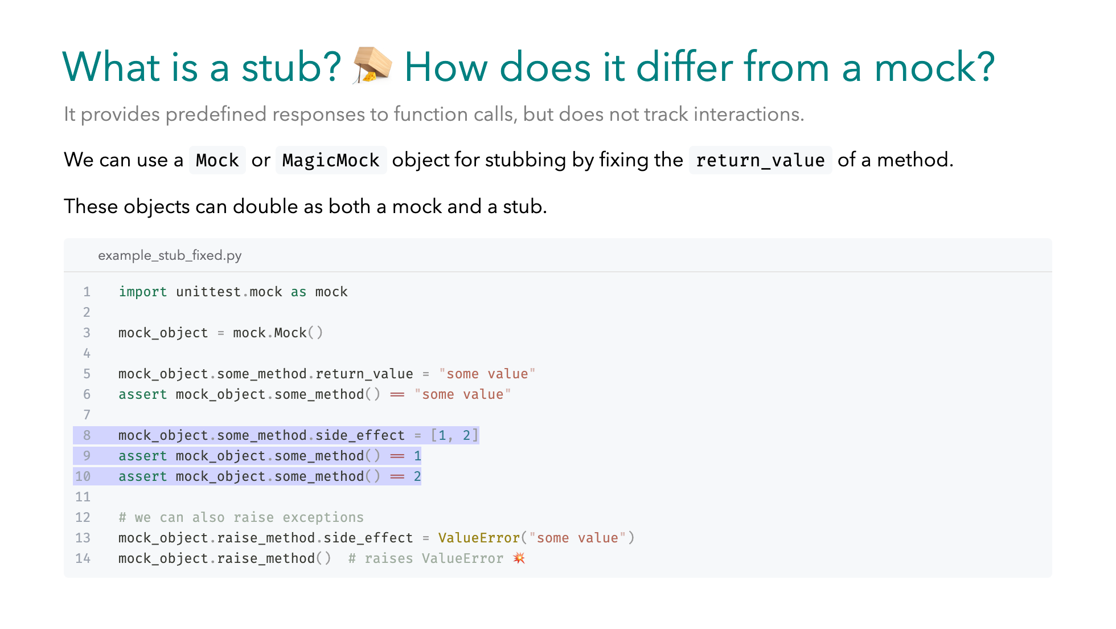
Notes:
As of now we have covered mocks but what is a stub, how does it differ? `Stubs` provide canned responses, helping us test outputs or control intermediate results. `Mock` & `MagicMock`, the usual suspects...can be used to provide these results...for functions that we expect to be called in our unit. In our example this function is called `some_method` -- One way to set fixed responses is to set the `return_value`, this way every call will always return `some_value` -- In the case of repeated calls with different return values we can provide an iterable to the `side_effect` attribute -- Finally, to test against errors we can use `side_effect` to raise Exceptions like a `ValueError`

Slide 24
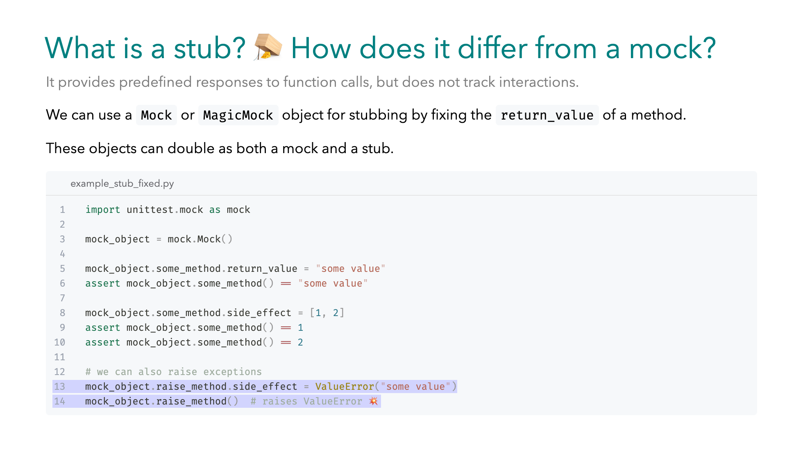
Notes:
As of now we have covered mocks but what is a stub, how does it differ? `Stubs` provide canned responses, helping us test outputs or control intermediate results. `Mock` & `MagicMock`, the usual suspects...can be used to provide these results...for functions that we expect to be called in our unit. In our example this function is called `some_method` -- One way to set fixed responses is to set the `return_value`, this way every call will always return `some_value` -- In the case of repeated calls with different return values we can provide an iterable to the `side_effect` attribute -- Finally, to test against errors we can use `side_effect` to raise Exceptions like a `ValueError`

Slide 25
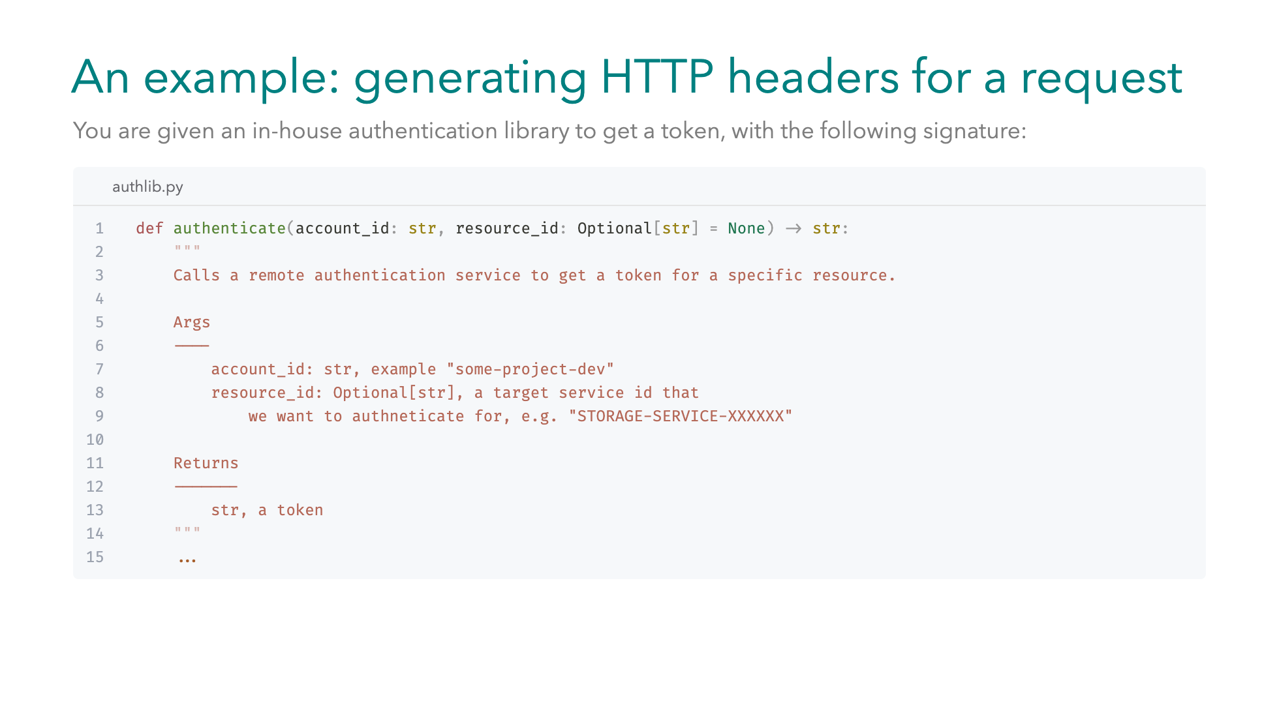
Notes:
Let's see an example. We have an in-house authentication library with a function called authenticate. It goes off to some remote service and gives us back a token. It takes an account_id — that’s required — and an optional resource_id. The idea is: sometimes we want a generic token for an account but other times we need a token specific to a resource, like a storage service.

Slide 26
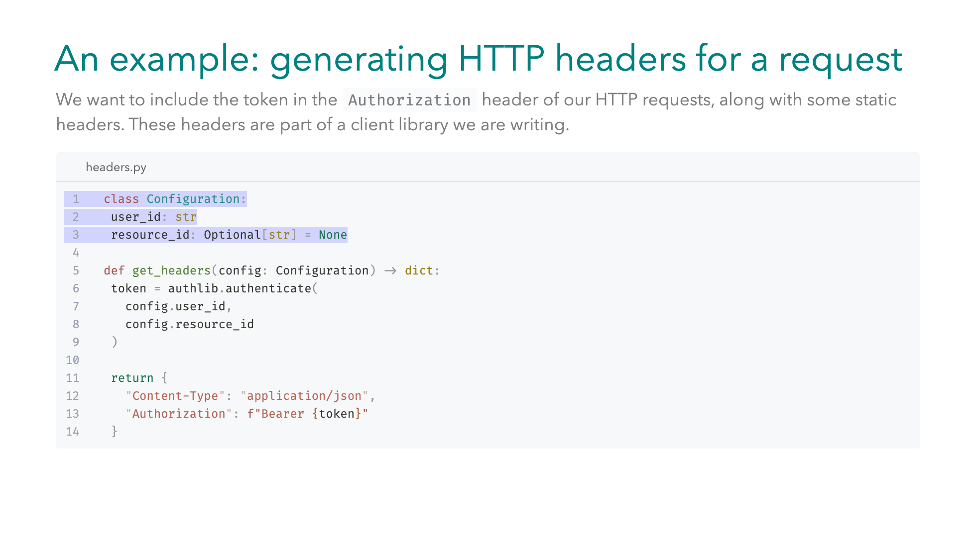
Notes:
Our utility function get_headers takes this configuration, -- calls authlib.authenticate, and uses the returned token to build a dictionary of HTTP headers. -- We include the token in the Authorization header of our request, along some static headers like content-type. When testing get_headers, we need to make sure to replace authenticate with a test double but what type of test double to use in this case?

Slide 27
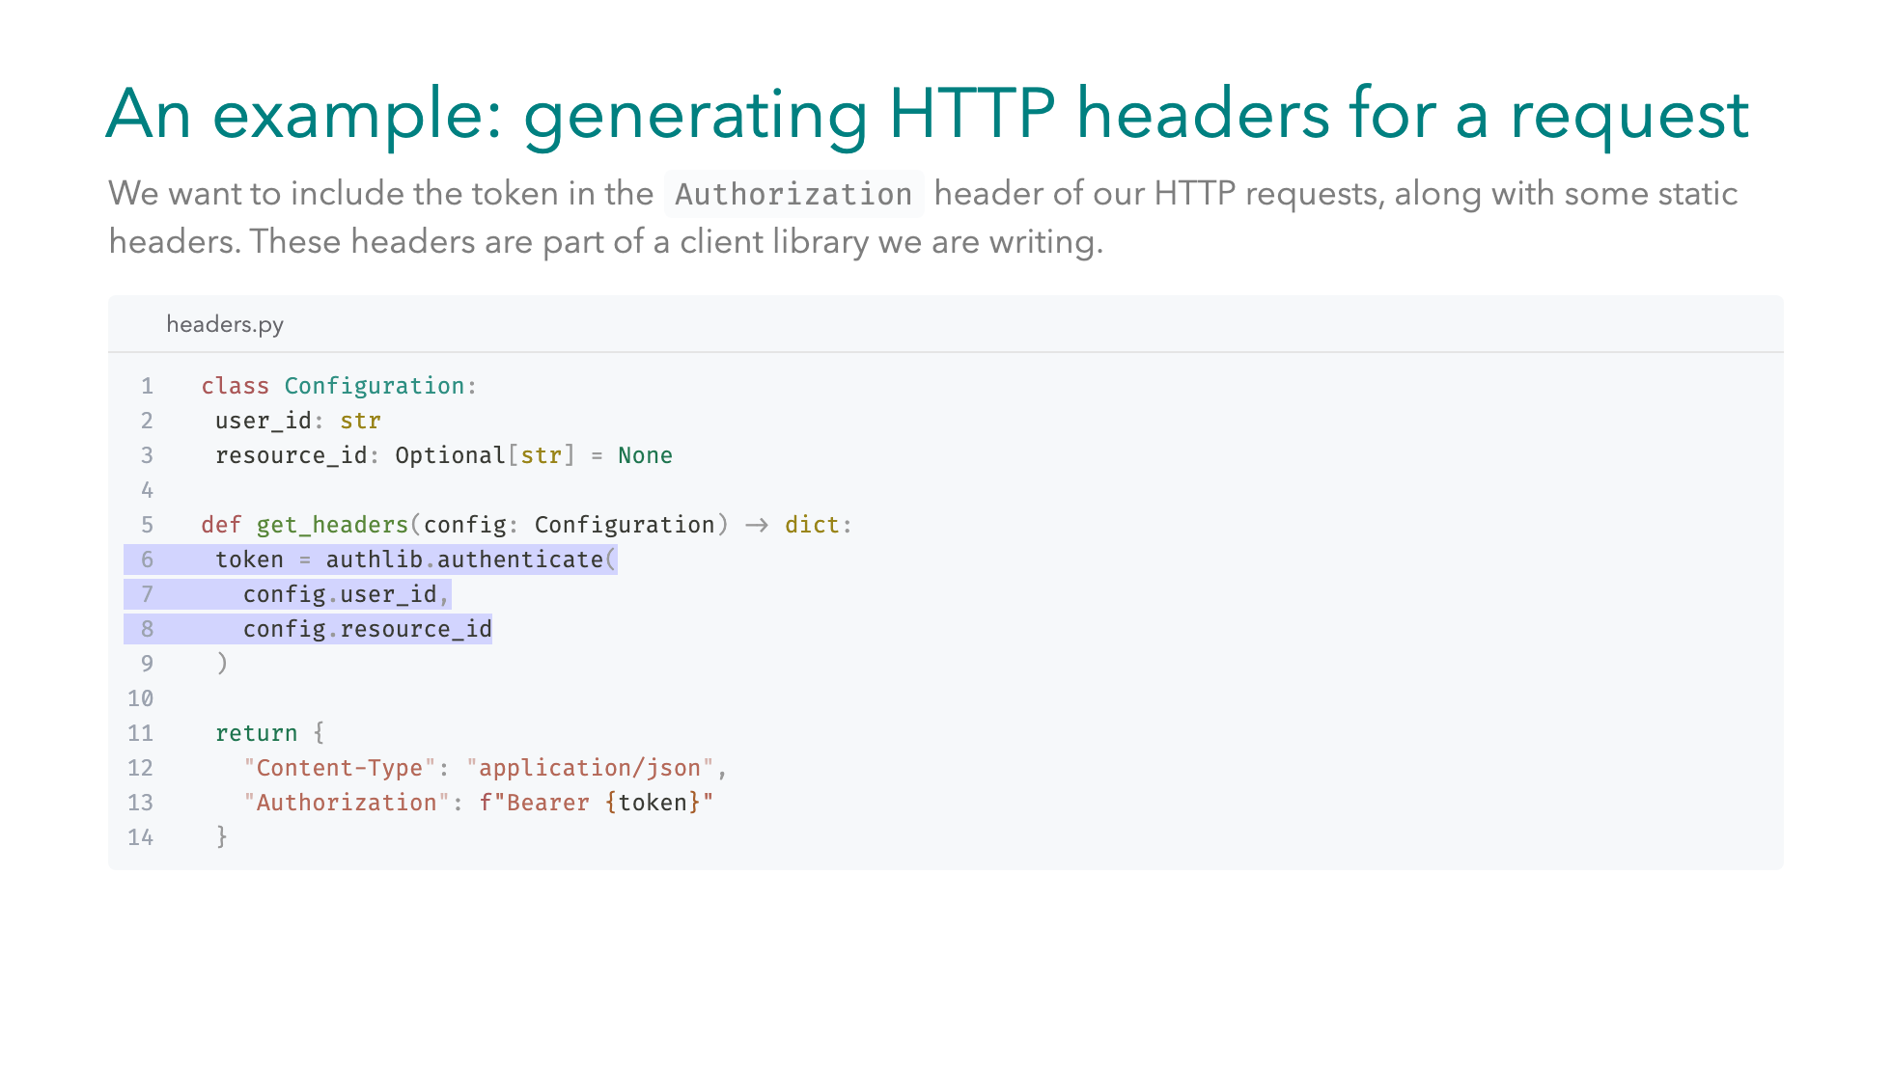
Notes:
Our utility function get_headers takes this configuration, -- calls authlib.authenticate, and uses the returned token to build a dictionary of HTTP headers. -- We include the token in the Authorization header of our request, along some static headers like content-type. When testing get_headers, we need to make sure to replace authenticate with a test double but what type of test double to use in this case?

Slide 28
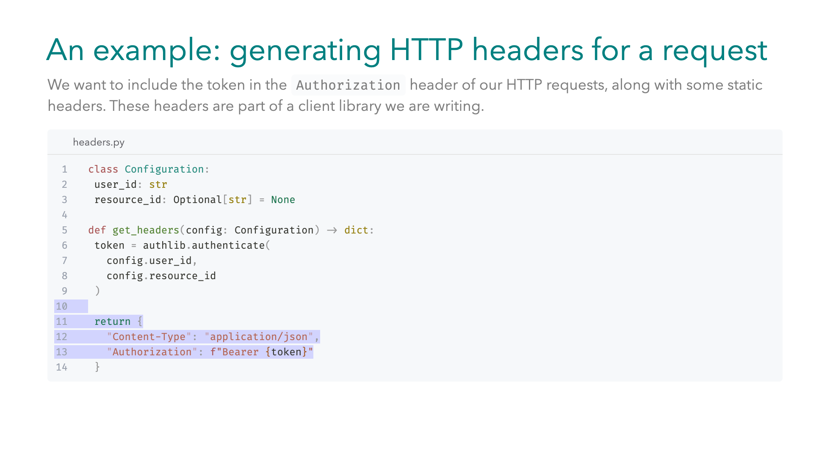
Notes:
Our utility function get_headers takes this configuration, -- calls authlib.authenticate, and uses the returned token to build a dictionary of HTTP headers. -- We include the token in the Authorization header of our request, along some static headers like content-type. When testing get_headers, we need to make sure to replace authenticate with a test double but what type of test double to use in this case?

Slide 29
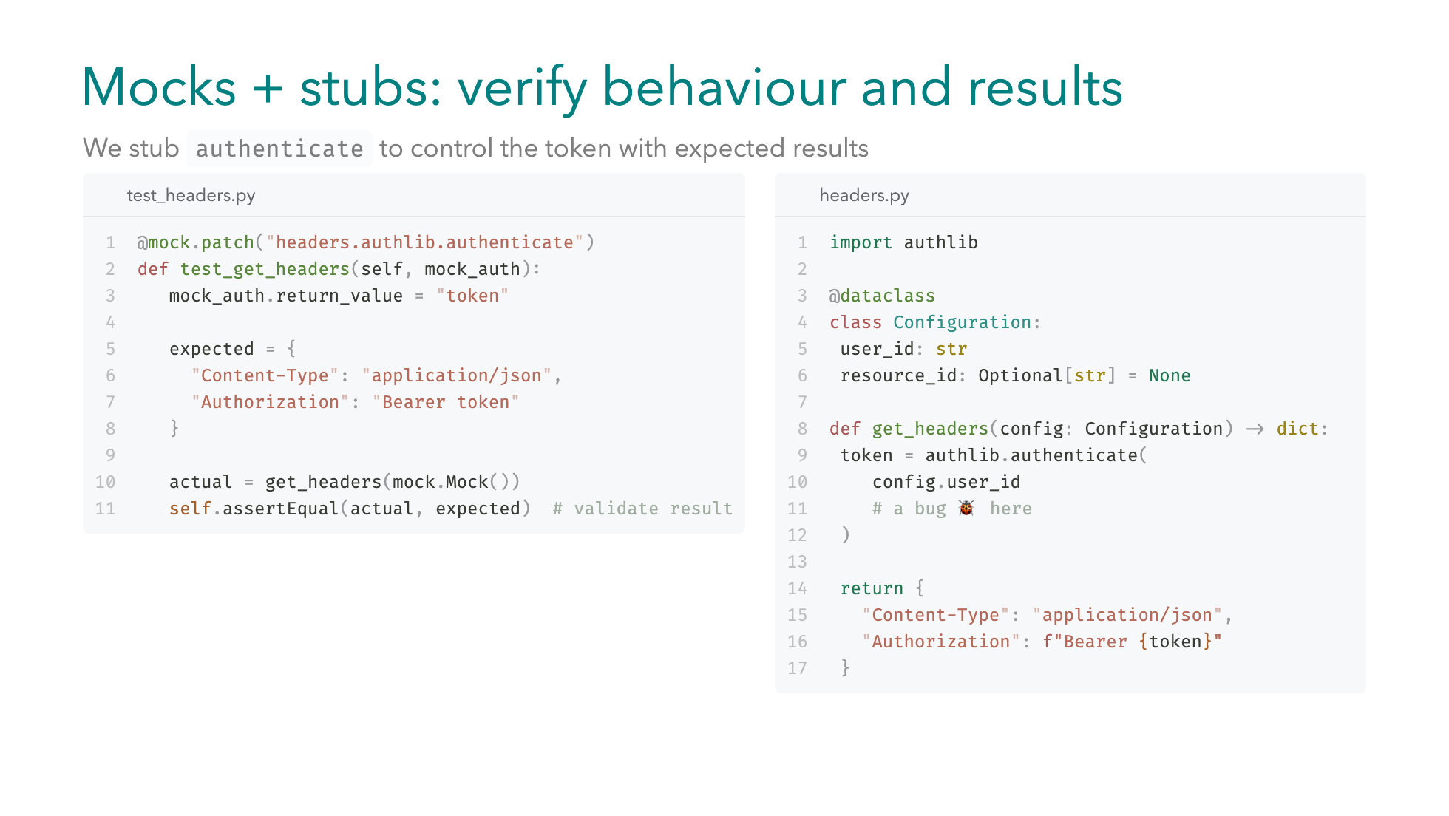
Notes:
Let's look at the left column. We maybe tempted to just stub authenticate by fixing its return value to a dummy `token` string. This test has full coverage, and it passes. But if you recall `authenticate`'s signature, in fact we didn't actually propagate the `resource_id` that we got in the configuration object. Our unit test would still be successful, but we would totally miss the link between `resource_id` and the generated token. -- To fix that, we can use mocks to also assert the arguments of the call to `authenticate`. Now if we forget to pass `resource_id`, the test will fail, alerting us to the bug.

Slide 30
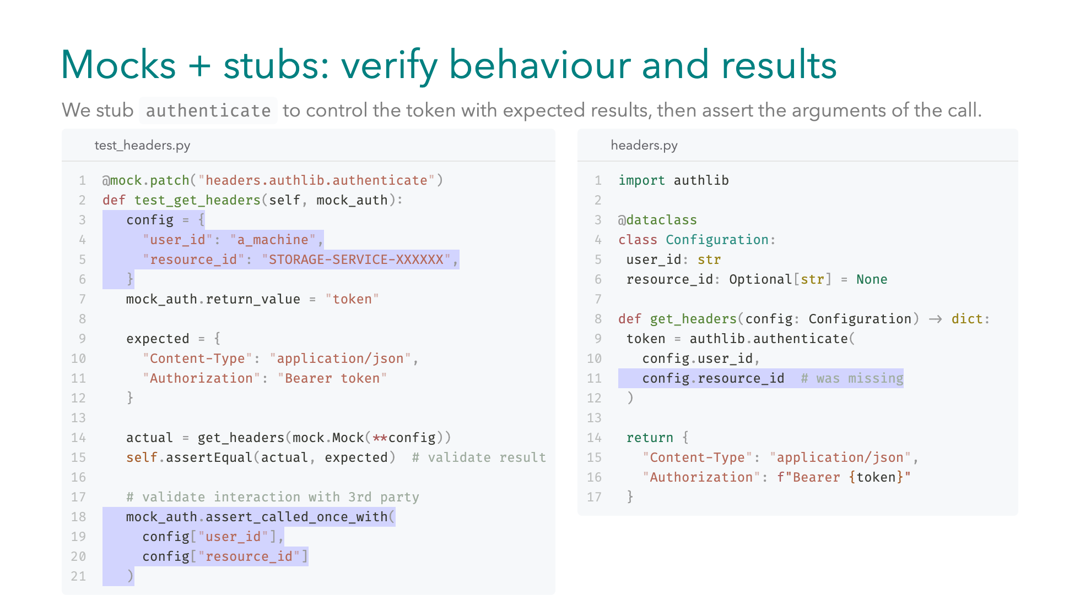
Notes:
Let's look at the left column. We maybe tempted to just stub authenticate by fixing its return value to a dummy `token` string. This test has full coverage, and it passes. But if you recall `authenticate`'s signature, in fact we didn't actually propagate the `resource_id` that we got in the configuration object. Our unit test would still be successful, but we would totally miss the link between `resource_id` and the generated token. -- To fix that, we can use mocks to also assert the arguments of the call to `authenticate`. Now if we forget to pass `resource_id`, the test will fail, alerting us to the bug.

Slide 31
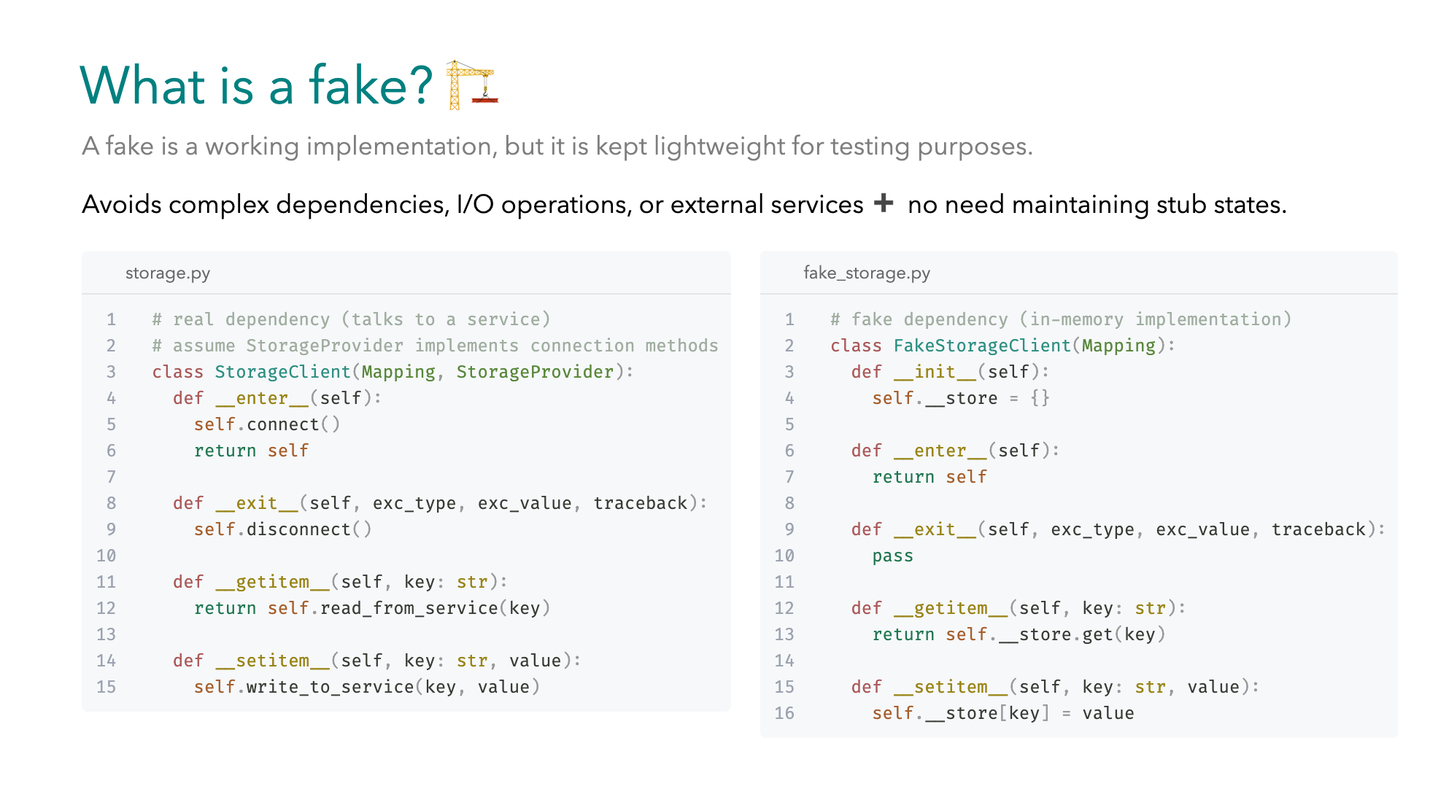
Notes:
Do we have to always use stubs? What is a fake? A fake is a working implementation of a real object, but simplified for testing. Unlike stubs, you don’t have to predefine return values. The fake behaves like the real thing, just without the heavy parts. That means no network calls, no file I/O, and no external services but ... still with realistic behavior. Let's see an example: ~ On the left, the real StorageClient - let's suppose it follows the Mapping protocol, and it behaves like a dictionary with `getitem` and `setitem`. It also supports the context manager protocol, as we saw this means that it has `enter` & `exit` magic methods. And it talks to real a service, with implementation methods provided by `StorageProvider` base class. ~ On the right, the `FakeStorageClient` just uses an in-memory dictionary, instead of connecting to the real thing. This keeps implementation lightweight, avoids maintaining stub states and makes tests faster and more reliable. While being close enough to production behavior.

Slide 32
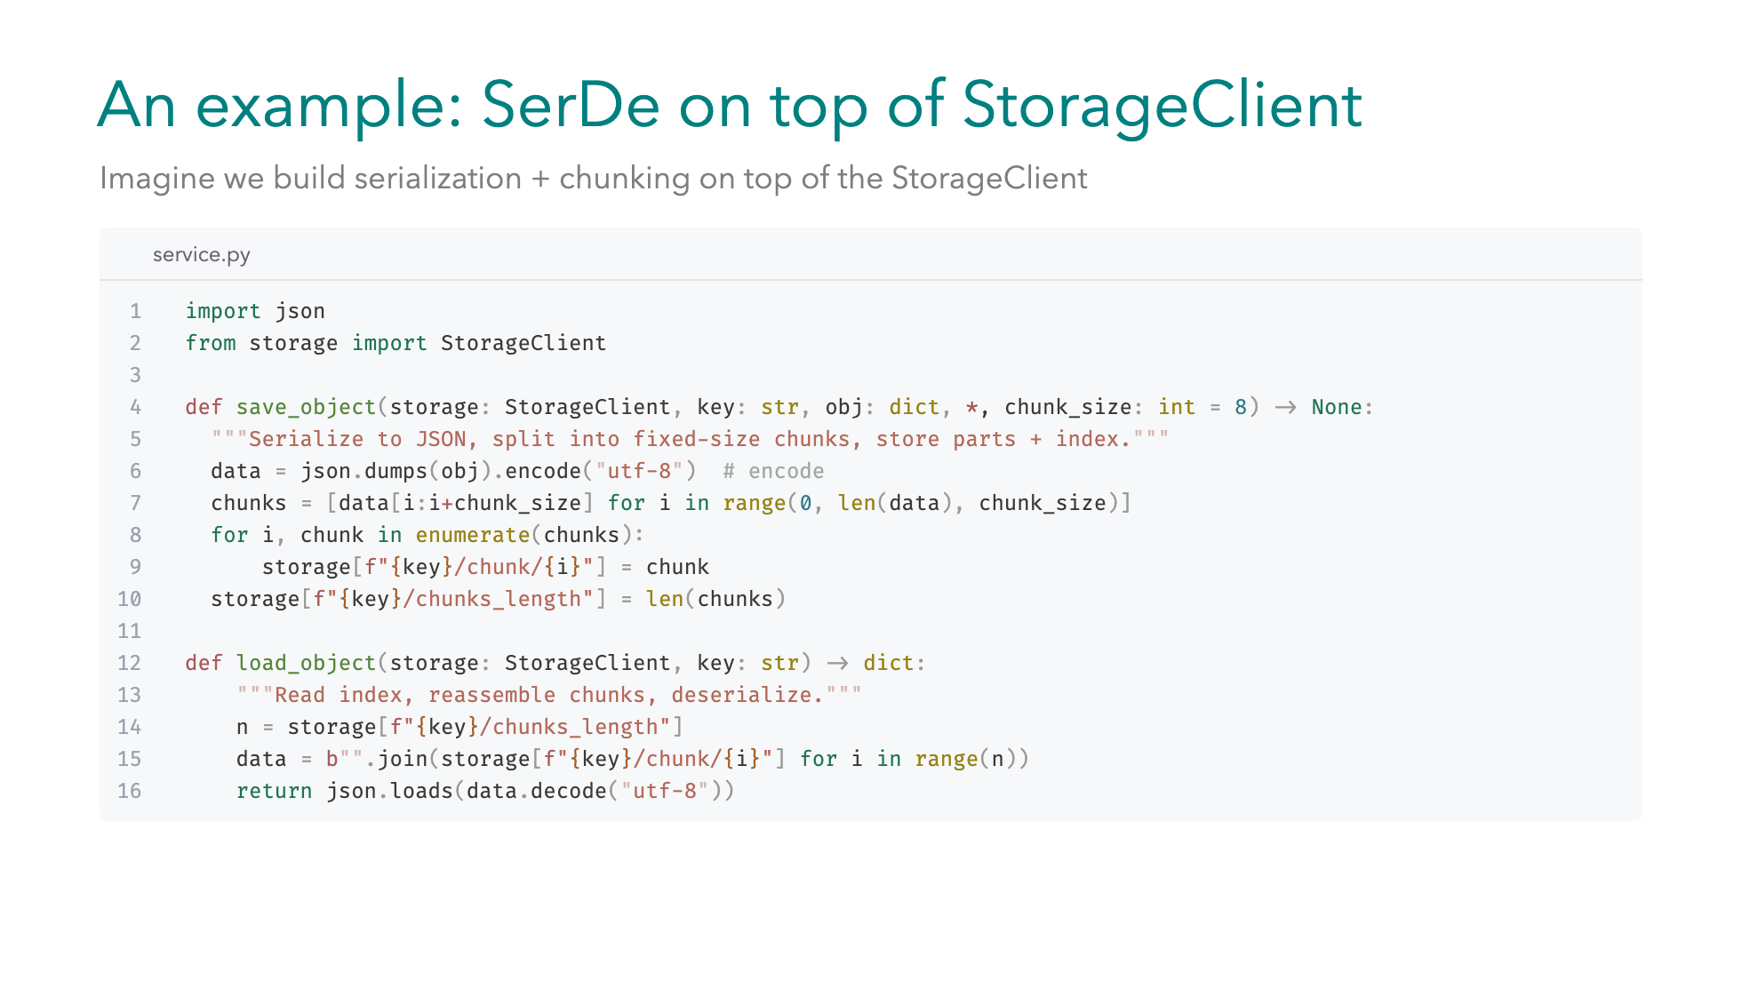
Notes:
Let's suppose we need to build a more complex storage client, with serialization and chunking, due to some practical network restrictions. Let's also suppose we cannot modularize the code further. -1- We have the `save_object` function that takes a `StorageClient`, a `key` which will be the name of the object inside ... our storage, and the `obj` which is the `dictionary` to be saved. -2- Next we serialize the `dictionary` to json format and we encode. -3- Now we have the serialized data and we need to chunk them based on the `chunk_size` parameter -4- we also keep track of the `chunks length` to help us during reassembly -5- For the `load_object` we accept the `StorageClient`, and the `key` of the object. -6- We need to reverse the operations, so we first retrieve the number of chunks -7- Then we assemble the chunks in a `bytes` object -8- And finally we decode the `bytes` and load the `json` string.

Slide 33
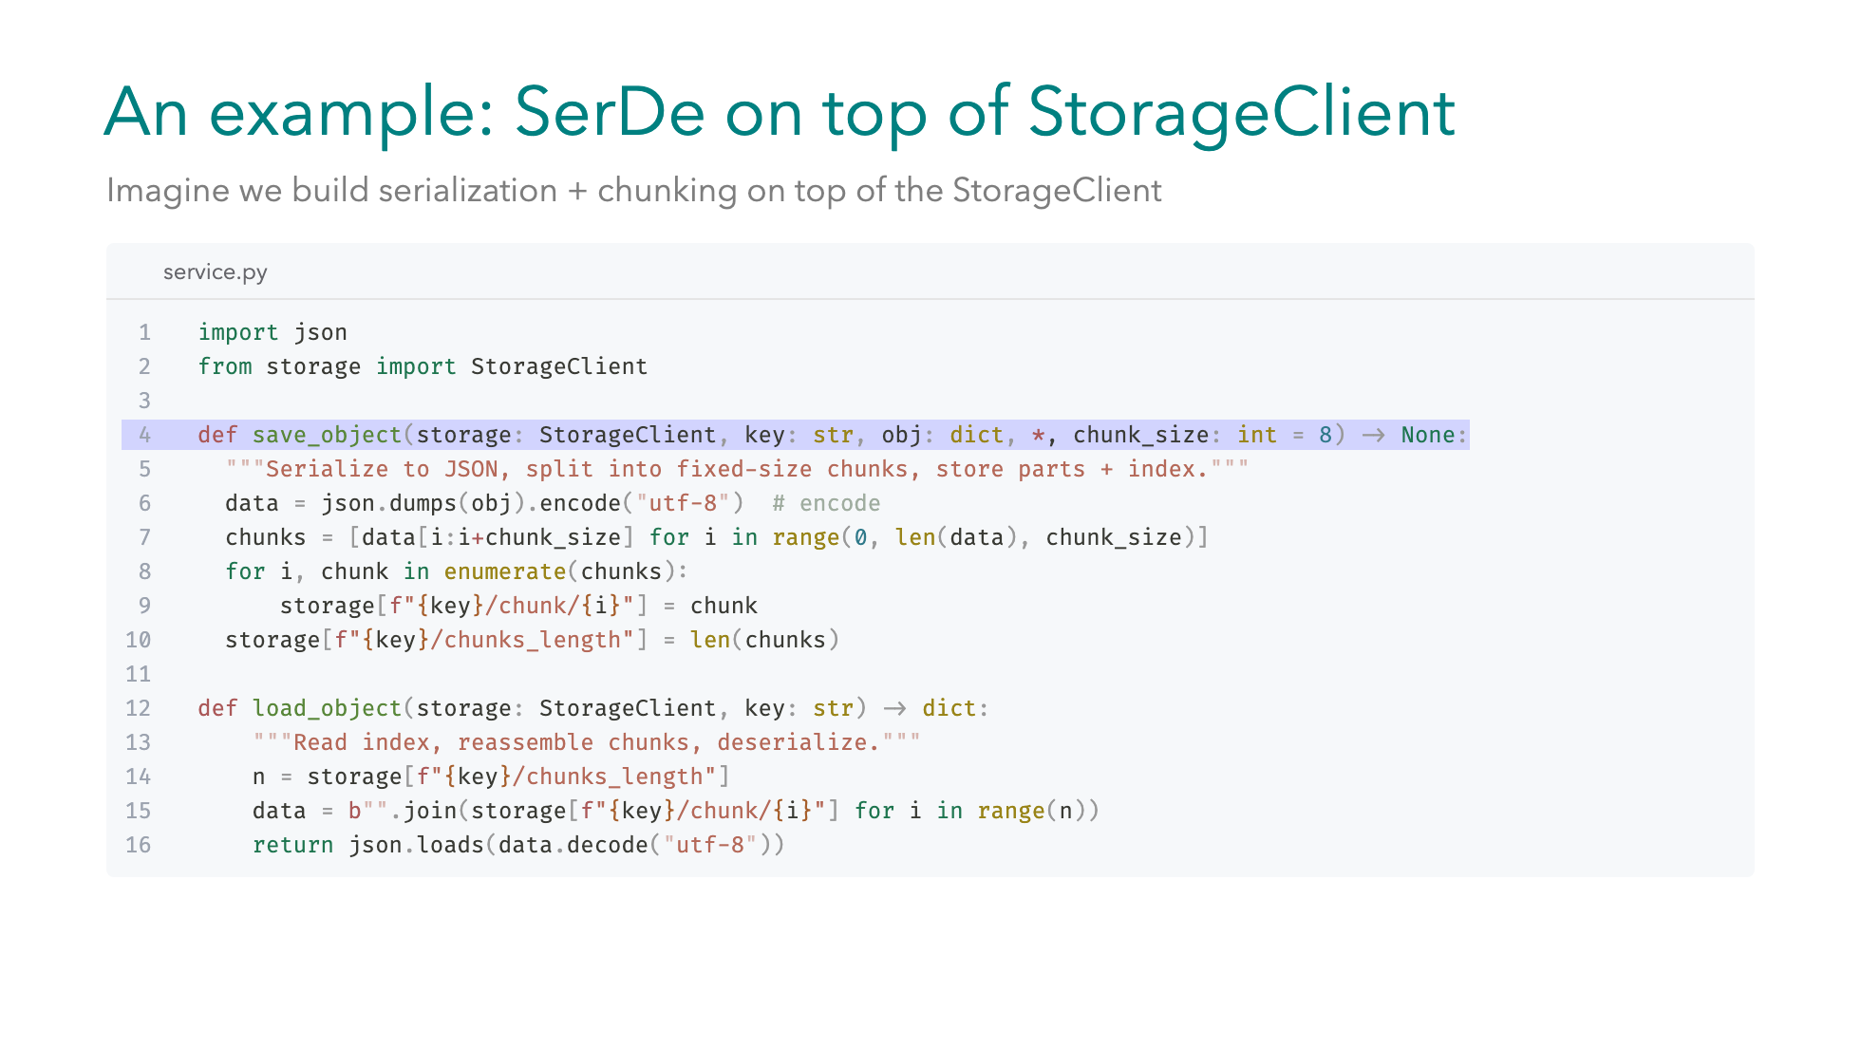
Notes:
Let's suppose we need to build a more complex storage client, with serialization and chunking, due to some practical network restrictions. Let's also suppose we cannot modularize the code further. -1- We have the `save_object` function that takes a `StorageClient`, a `key` which will be the name of the object inside ... our storage, and the `obj` which is the `dictionary` to be saved. -2- Next we serialize the `dictionary` to json format and we encode. -3- Now we have the serialized data and we need to chunk them based on the `chunk_size` parameter -4- we also keep track of the `chunks length` to help us during reassembly -5- For the `load_object` we accept the `StorageClient`, and the `key` of the object. -6- We need to reverse the operations, so we first retrieve the number of chunks -7- Then we assemble the chunks in a `bytes` object -8- And finally we decode the `bytes` and load the `json` string.

Slide 34
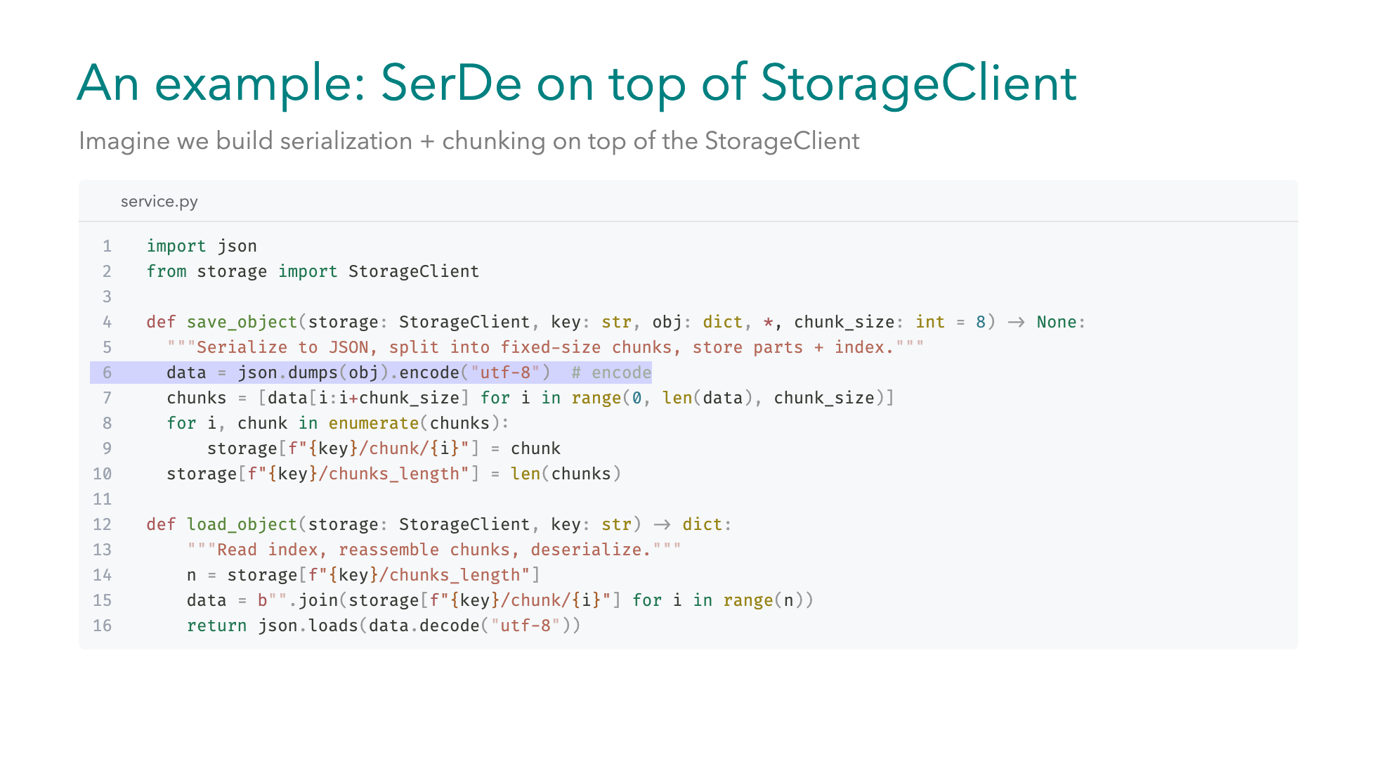
Notes:
Let's suppose we need to build a more complex storage client, with serialization and chunking, due to some practical network restrictions. Let's also suppose we cannot modularize the code further. -1- We have the `save_object` function that takes a `StorageClient`, a `key` which will be the name of the object inside ... our storage, and the `obj` which is the `dictionary` to be saved. -2- Next we serialize the `dictionary` to json format and we encode. -3- Now we have the serialized data and we need to chunk them based on the `chunk_size` parameter -4- we also keep track of the `chunks length` to help us during reassembly -5- For the `load_object` we accept the `StorageClient`, and the `key` of the object. -6- We need to reverse the operations, so we first retrieve the number of chunks -7- Then we assemble the chunks in a `bytes` object -8- And finally we decode the `bytes` and load the `json` string.

Slide 35
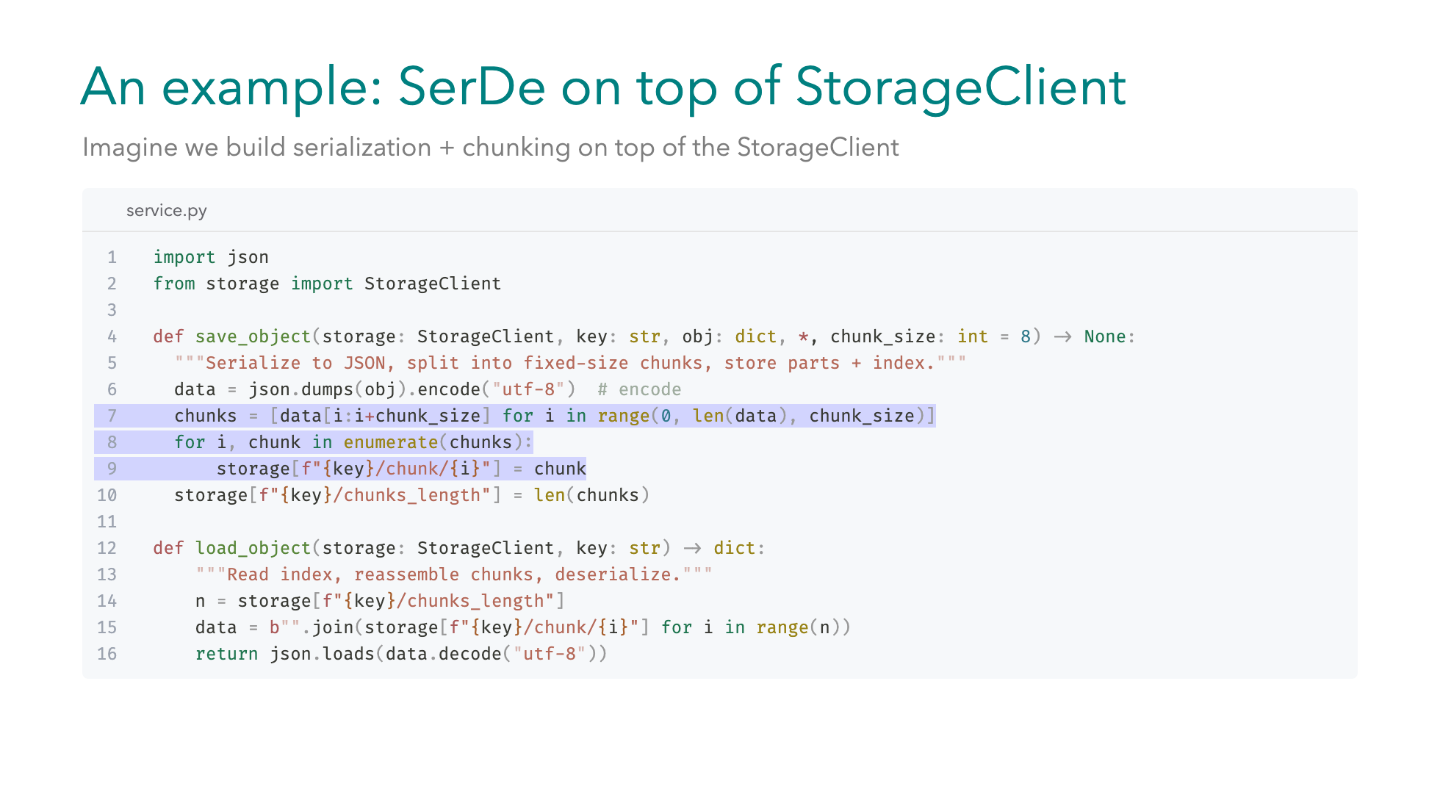
Notes:
Let's suppose we need to build a more complex storage client, with serialization and chunking, due to some practical network restrictions. Let's also suppose we cannot modularize the code further. -1- We have the `save_object` function that takes a `StorageClient`, a `key` which will be the name of the object inside ... our storage, and the `obj` which is the `dictionary` to be saved. -2- Next we serialize the `dictionary` to json format and we encode. -3- Now we have the serialized data and we need to chunk them based on the `chunk_size` parameter -4- we also keep track of the `chunks length` to help us during reassembly -5- For the `load_object` we accept the `StorageClient`, and the `key` of the object. -6- We need to reverse the operations, so we first retrieve the number of chunks -7- Then we assemble the chunks in a `bytes` object -8- And finally we decode the `bytes` and load the `json` string.

Slide 36
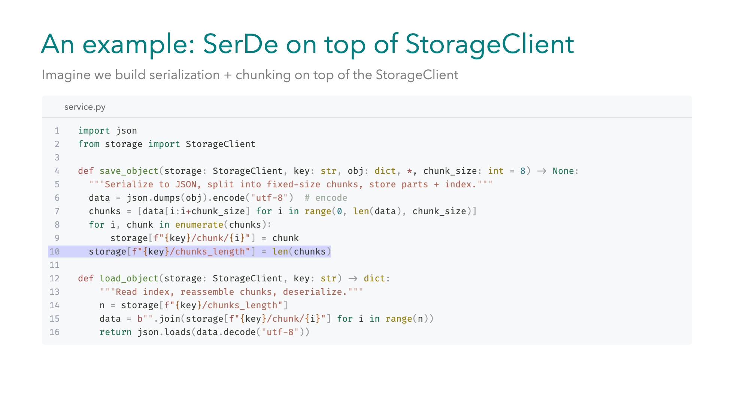
Notes:
Let's suppose we need to build a more complex storage client, with serialization and chunking, due to some practical network restrictions. Let's also suppose we cannot modularize the code further. -1- We have the `save_object` function that takes a `StorageClient`, a `key` which will be the name of the object inside ... our storage, and the `obj` which is the `dictionary` to be saved. -2- Next we serialize the `dictionary` to json format and we encode. -3- Now we have the serialized data and we need to chunk them based on the `chunk_size` parameter -4- we also keep track of the `chunks length` to help us during reassembly -5- For the `load_object` we accept the `StorageClient`, and the `key` of the object. -6- We need to reverse the operations, so we first retrieve the number of chunks -7- Then we assemble the chunks in a `bytes` object -8- And finally we decode the `bytes` and load the `json` string.

Slide 37
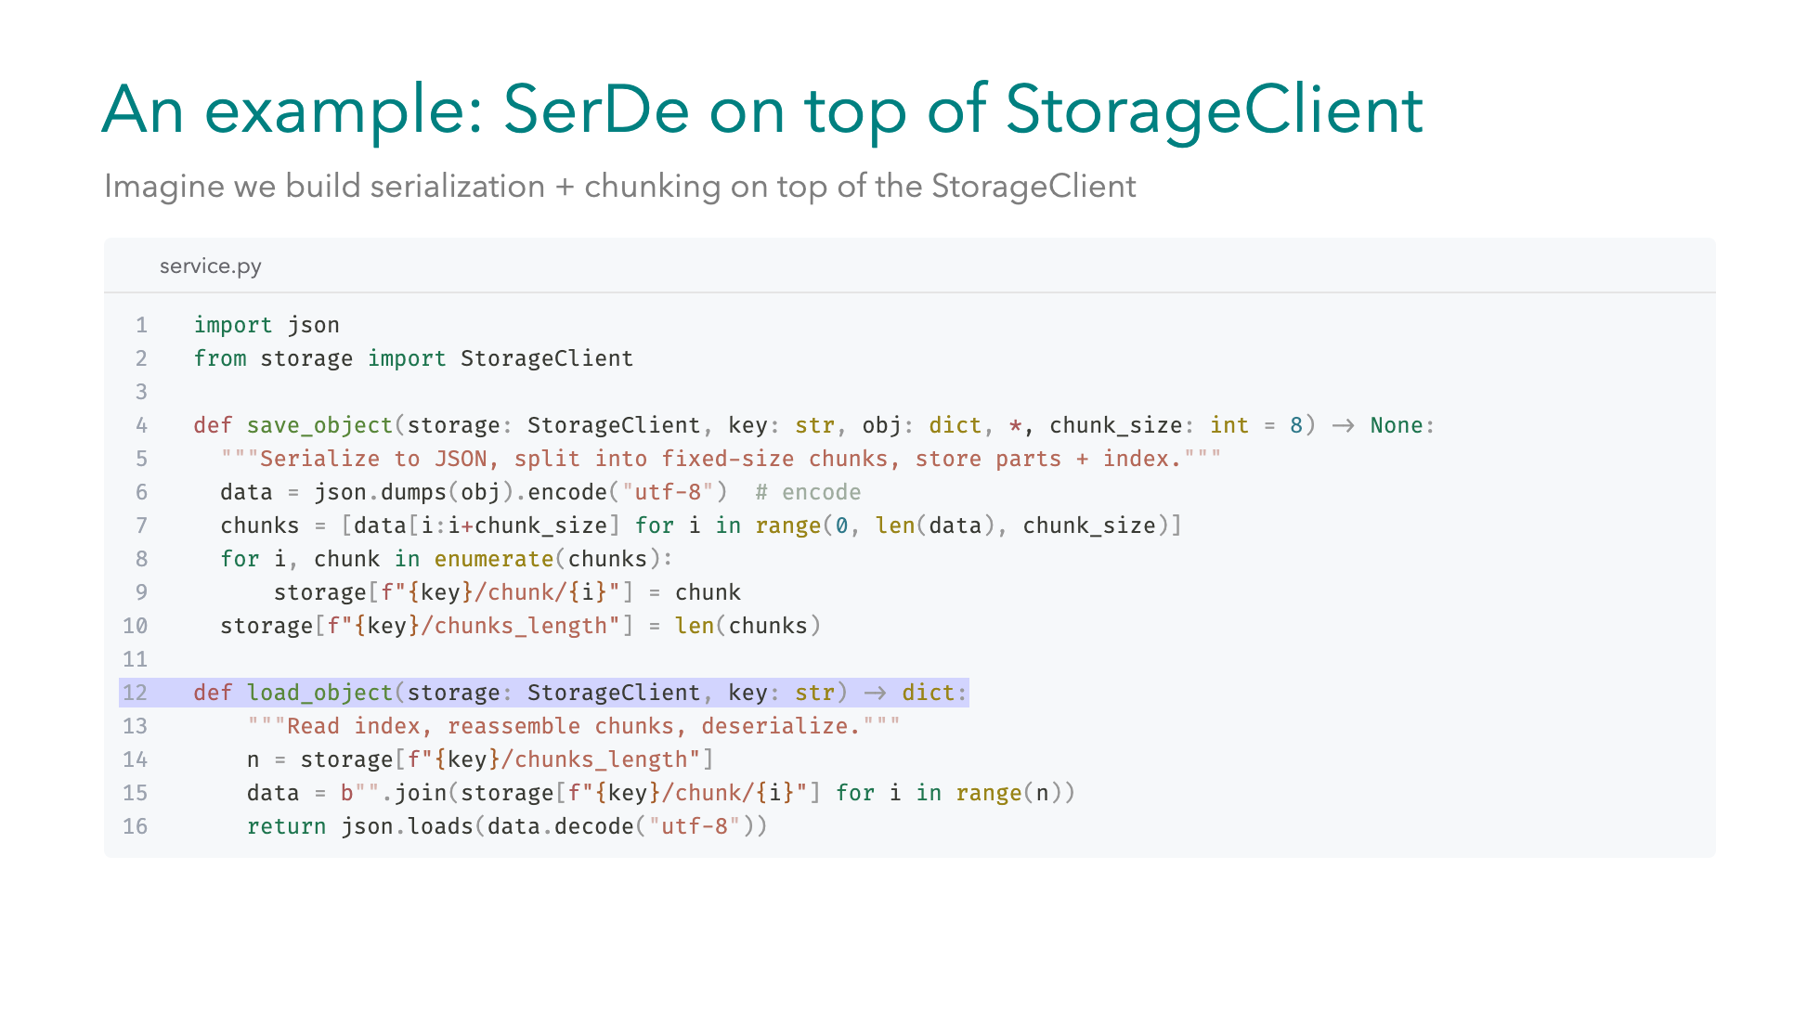
Notes:
Let's suppose we need to build a more complex storage client, with serialization and chunking, due to some practical network restrictions. Let's also suppose we cannot modularize the code further. -1- We have the `save_object` function that takes a `StorageClient`, a `key` which will be the name of the object inside ... our storage, and the `obj` which is the `dictionary` to be saved. -2- Next we serialize the `dictionary` to json format and we encode. -3- Now we have the serialized data and we need to chunk them based on the `chunk_size` parameter -4- we also keep track of the `chunks length` to help us during reassembly -5- For the `load_object` we accept the `StorageClient`, and the `key` of the object. -6- We need to reverse the operations, so we first retrieve the number of chunks -7- Then we assemble the chunks in a `bytes` object -8- And finally we decode the `bytes` and load the `json` string.

Slide 38
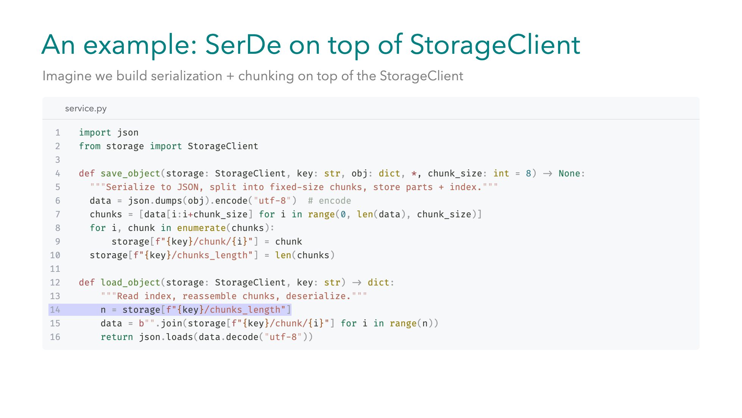
Notes:
Let's suppose we need to build a more complex storage client, with serialization and chunking, due to some practical network restrictions. Let's also suppose we cannot modularize the code further. -1- We have the `save_object` function that takes a `StorageClient`, a `key` which will be the name of the object inside ... our storage, and the `obj` which is the `dictionary` to be saved. -2- Next we serialize the `dictionary` to json format and we encode. -3- Now we have the serialized data and we need to chunk them based on the `chunk_size` parameter -4- we also keep track of the `chunks length` to help us during reassembly -5- For the `load_object` we accept the `StorageClient`, and the `key` of the object. -6- We need to reverse the operations, so we first retrieve the number of chunks -7- Then we assemble the chunks in a `bytes` object -8- And finally we decode the `bytes` and load the `json` string.

Slide 39
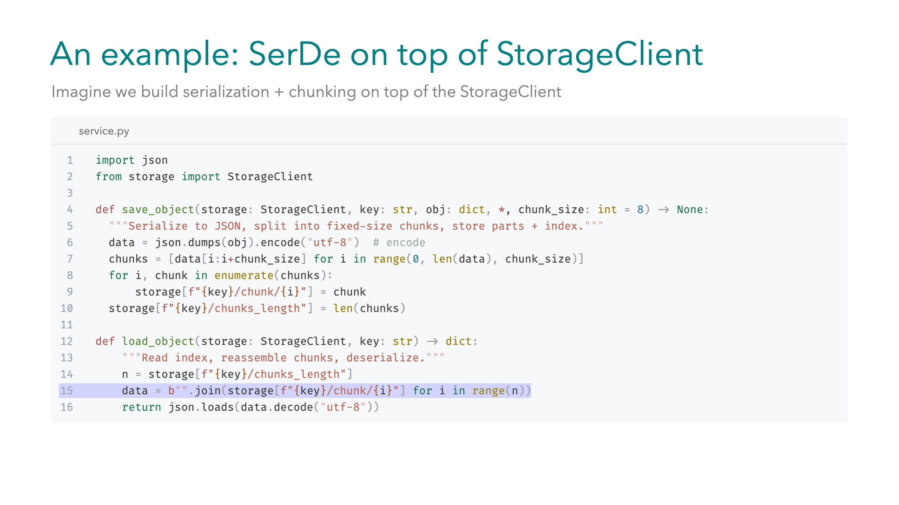
Notes:
Let's suppose we need to build a more complex storage client, with serialization and chunking, due to some practical network restrictions. Let's also suppose we cannot modularize the code further. -1- We have the `save_object` function that takes a `StorageClient`, a `key` which will be the name of the object inside ... our storage, and the `obj` which is the `dictionary` to be saved. -2- Next we serialize the `dictionary` to json format and we encode. -3- Now we have the serialized data and we need to chunk them based on the `chunk_size` parameter -4- we also keep track of the `chunks length` to help us during reassembly -5- For the `load_object` we accept the `StorageClient`, and the `key` of the object. -6- We need to reverse the operations, so we first retrieve the number of chunks -7- Then we assemble the chunks in a `bytes` object -8- And finally we decode the `bytes` and load the `json` string.

Slide 40
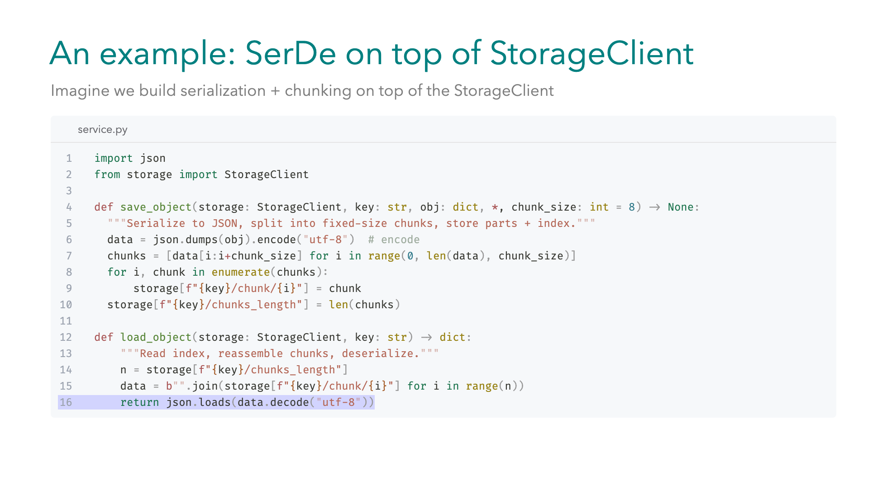
Notes:
Let's suppose we need to build a more complex storage client, with serialization and chunking, due to some practical network restrictions. Let's also suppose we cannot modularize the code further. -1- We have the `save_object` function that takes a `StorageClient`, a `key` which will be the name of the object inside ... our storage, and the `obj` which is the `dictionary` to be saved. -2- Next we serialize the `dictionary` to json format and we encode. -3- Now we have the serialized data and we need to chunk them based on the `chunk_size` parameter -4- we also keep track of the `chunks length` to help us during reassembly -5- For the `load_object` we accept the `StorageClient`, and the `key` of the object. -6- We need to reverse the operations, so we first retrieve the number of chunks -7- Then we assemble the chunks in a `bytes` object -8- And finally we decode the `bytes` and load the `json` string.

Slide 41
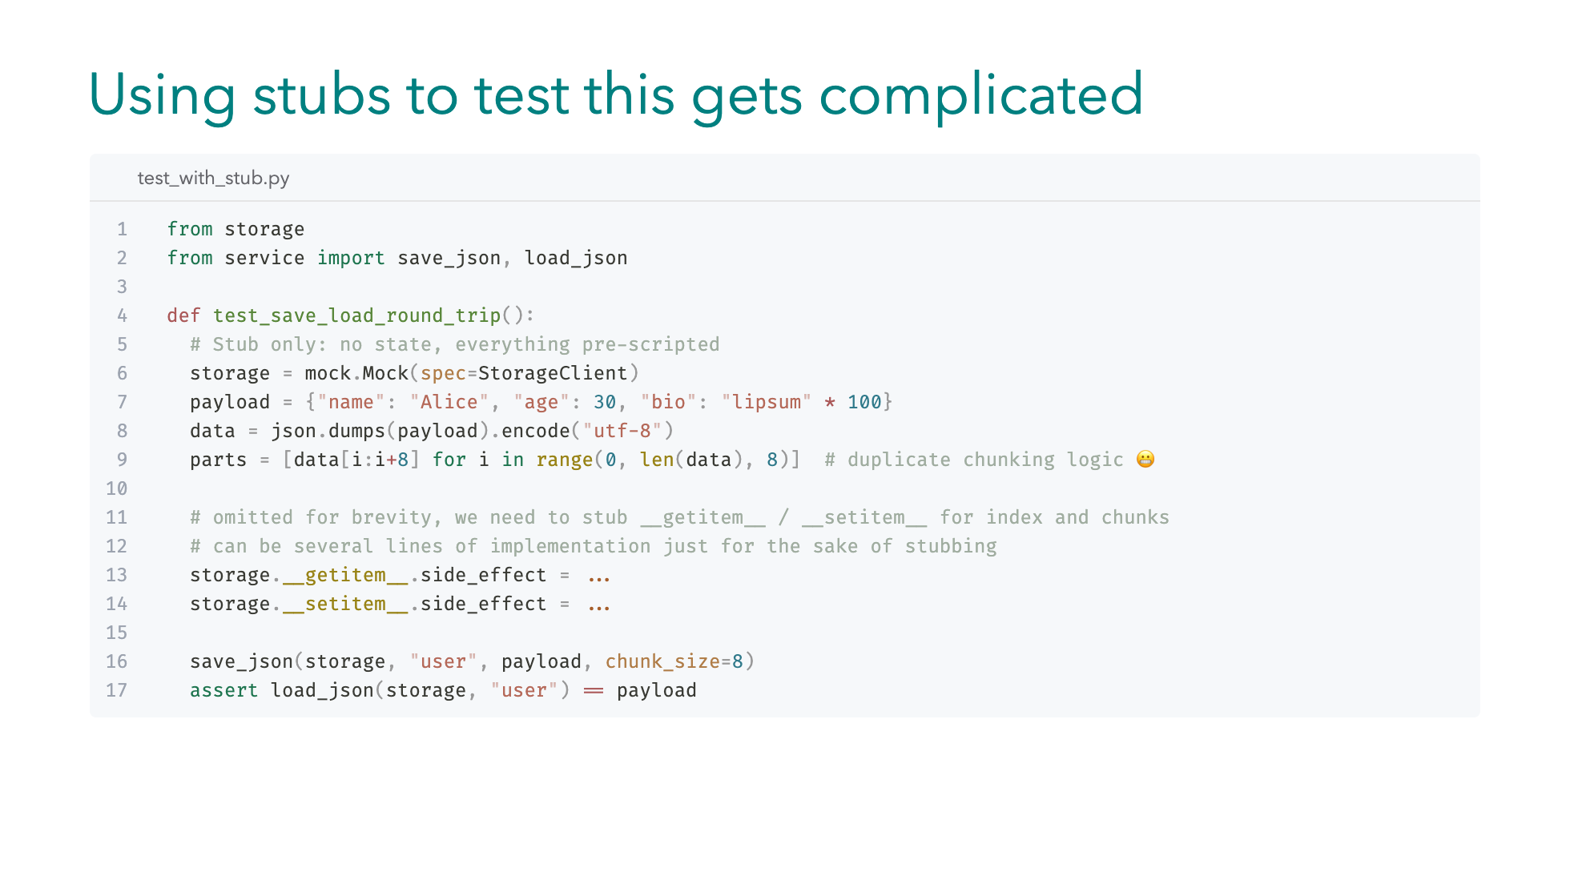
Notes:
We also need to test this, would stubbing be a good choice here? Well stubbing can easily get complicated in this case -- We need to reimplement the chunking logic of the real solution to produce the intermediate stubs for the serialization and deserialization -- What's more we need complex logic for getting and setting the individual `chunks` and the `chunk_length`. And you can imagine how convoluted this can be in a few iterations. If we need to add a new step or change the serialization step...for a compression step.

Slide 42
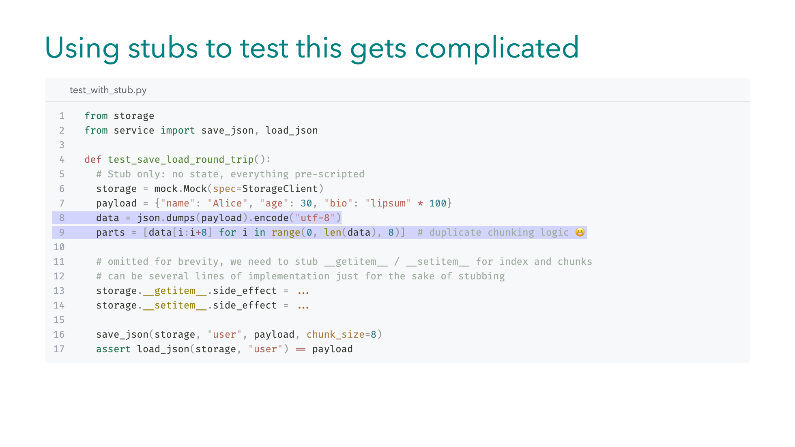
Notes:
We also need to test this, would stubbing be a good choice here? Well stubbing can easily get complicated in this case -- We need to reimplement the chunking logic of the real solution to produce the intermediate stubs for the serialization and deserialization -- What's more we need complex logic for getting and setting the individual `chunks` and the `chunk_length`. And you can imagine how convoluted this can be in a few iterations. If we need to add a new step or change the serialization step...for a compression step.

Slide 43
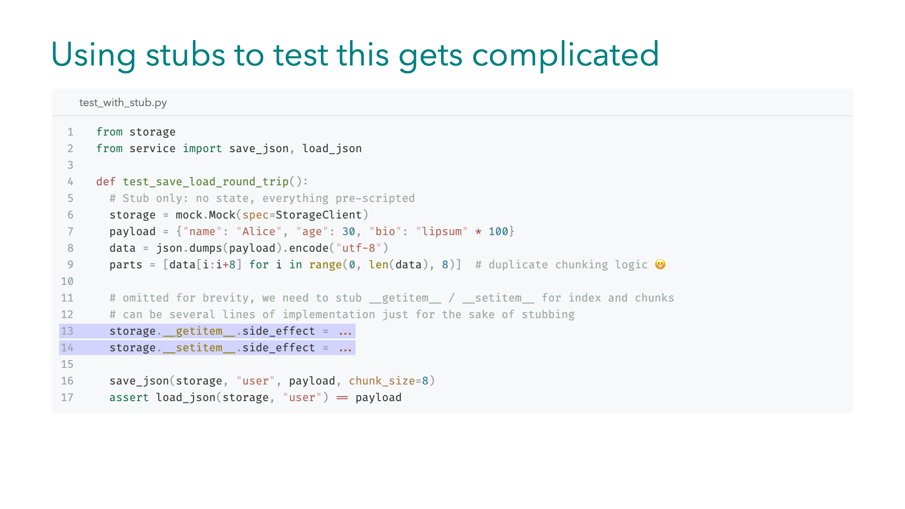
Notes:
We also need to test this, would stubbing be a good choice here? Well stubbing can easily get complicated in this case -- We need to reimplement the chunking logic of the real solution to produce the intermediate stubs for the serialization and deserialization -- What's more we need complex logic for getting and setting the individual `chunks` and the `chunk_length`. And you can imagine how convoluted this can be in a few iterations. If we need to add a new step or change the serialization step...for a compression step.

Slide 44
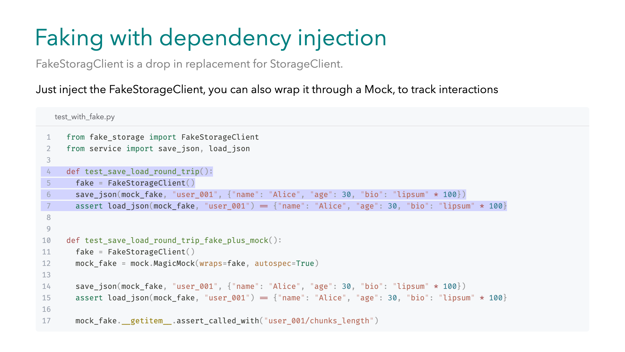
Notes:
`FakeStorageClient` comes to the rescue, as it provides a drop in ... lightweight replacement ... for the real `StorageClient`. And we don't even need to replace it via a patch since we use `Dependency Injection`. No need to maintain stub states. -- If we want to track the calls to the fake's `getitem` magic method, let's say to assert we retrieved the chunks length and didn't hardcode it inside the fake. We can wrap it with a `MagicMock`.

Slide 45
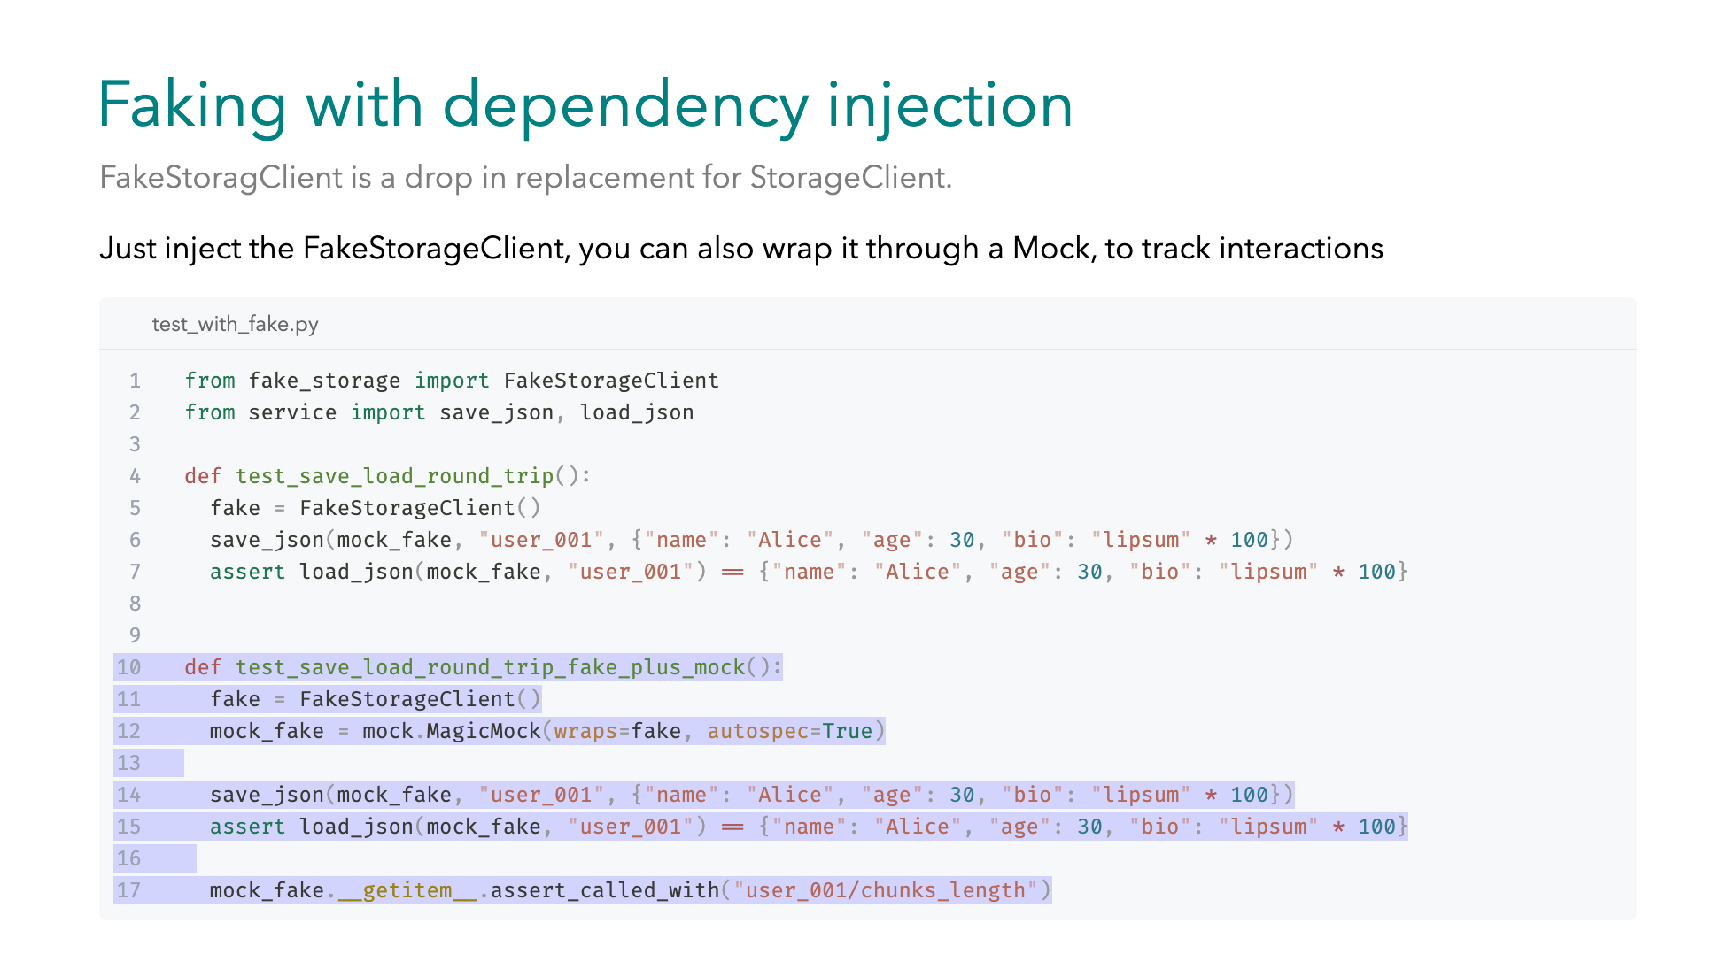
Notes:
`FakeStorageClient` comes to the rescue, as it provides a drop in ... lightweight replacement ... for the real `StorageClient`. And we don't even need to replace it via a patch since we use `Dependency Injection`. No need to maintain stub states. -- If we want to track the calls to the fake's `getitem` magic method, let's say to assert we retrieved the chunks length and didn't hardcode it inside the fake. We can wrap it with a `MagicMock`.

Slide 46
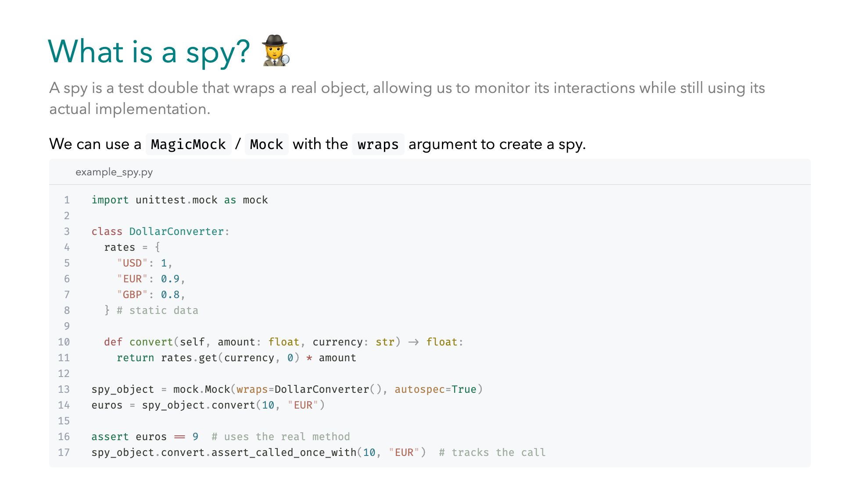
Notes:
What is a spy? A spy is a test double that wraps a real object, instead of the fake object we saw previously. Unlike a stub or a mock, it still runs the real implementation, but we also get to track interactions. -- In Python `unittest`, we can create one with Mock or MagicMock using the `wraps` argument. Here’s an example, called DollarConverter which has some static exchange rates. -- When we call convert(10 dollars to "EUR"), the spy runs the real logic and returns 9, just as expected. -- At the same time, because it’s also a mock, we can assert that the method was called once with the right arguments.

Slide 47
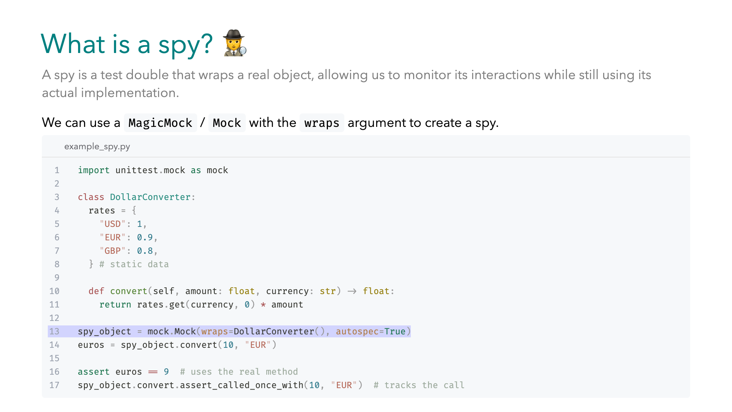
Notes:
What is a spy? A spy is a test double that wraps a real object, instead of the fake object we saw previously. Unlike a stub or a mock, it still runs the real implementation, but we also get to track interactions. -- In Python `unittest`, we can create one with Mock or MagicMock using the `wraps` argument. Here’s an example, called DollarConverter which has some static exchange rates. -- When we call convert(10 dollars to "EUR"), the spy runs the real logic and returns 9, just as expected. -- At the same time, because it’s also a mock, we can assert that the method was called once with the right arguments.

Slide 48
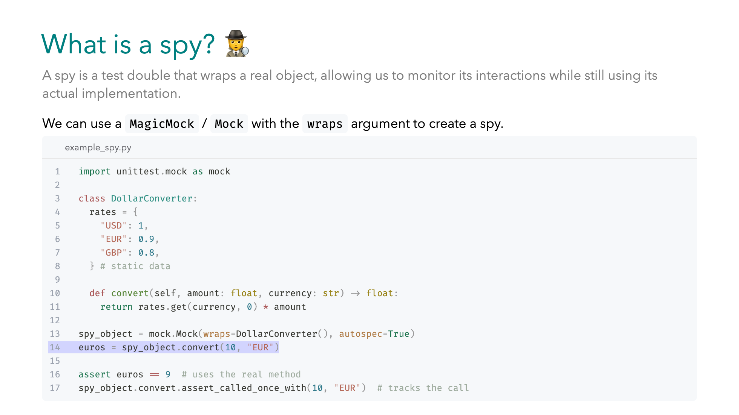
Notes:
What is a spy? A spy is a test double that wraps a real object, instead of the fake object we saw previously. Unlike a stub or a mock, it still runs the real implementation, but we also get to track interactions. -- In Python `unittest`, we can create one with Mock or MagicMock using the `wraps` argument. Here’s an example, called DollarConverter which has some static exchange rates. -- When we call convert(10 dollars to "EUR"), the spy runs the real logic and returns 9, just as expected. -- At the same time, because it’s also a mock, we can assert that the method was called once with the right arguments.

Slide 49
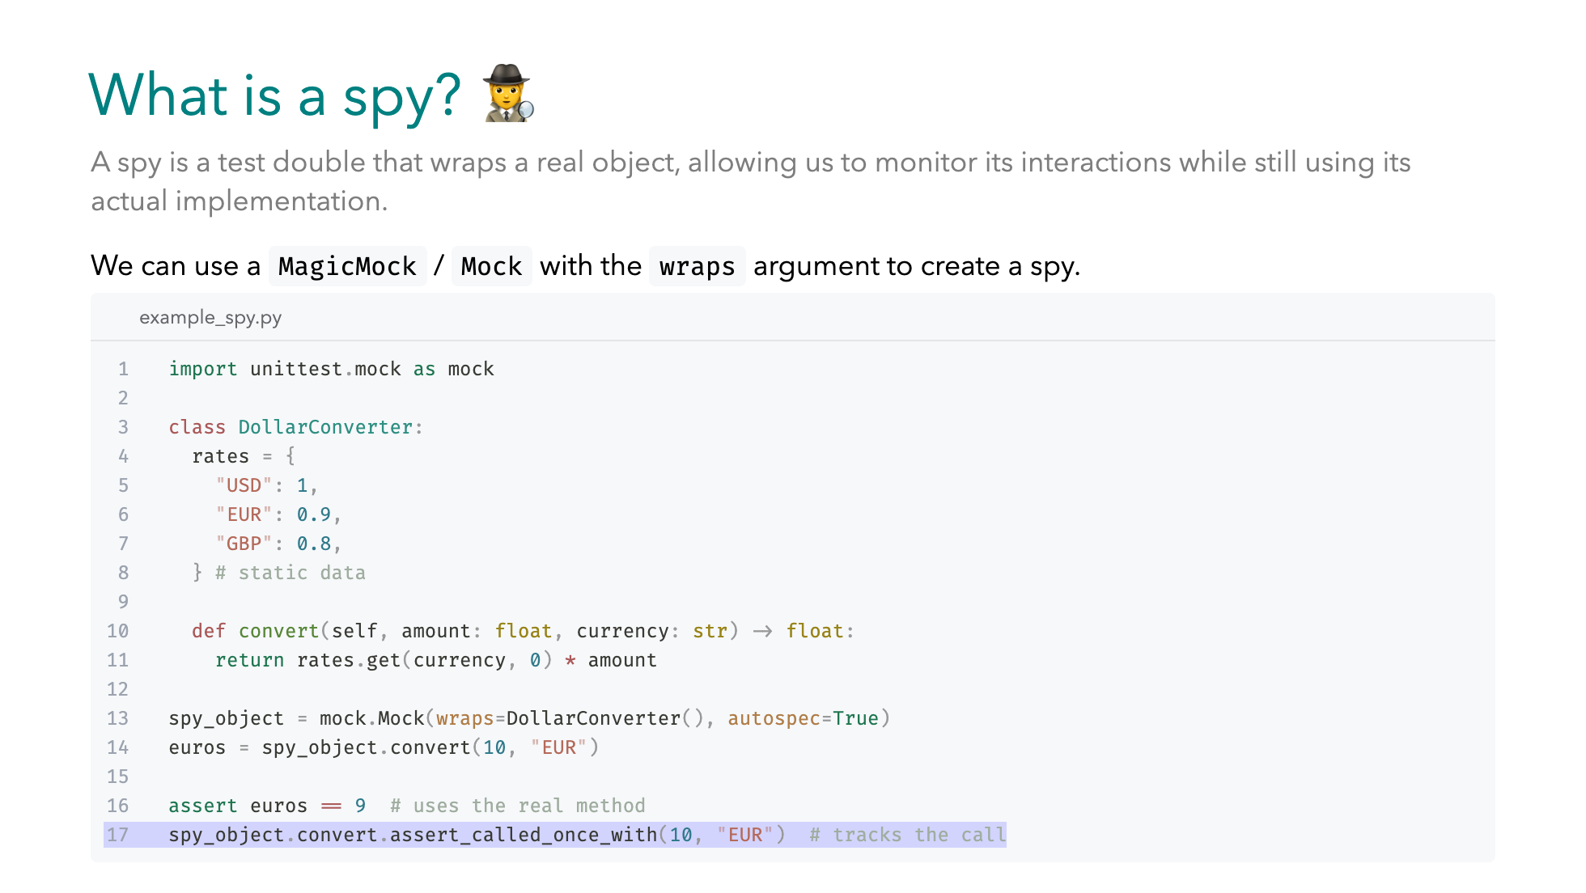
Notes:
What is a spy? A spy is a test double that wraps a real object, instead of the fake object we saw previously. Unlike a stub or a mock, it still runs the real implementation, but we also get to track interactions. -- In Python `unittest`, we can create one with Mock or MagicMock using the `wraps` argument. Here’s an example, called DollarConverter which has some static exchange rates. -- When we call convert(10 dollars to "EUR"), the spy runs the real logic and returns 9, just as expected. -- At the same time, because it’s also a mock, we can assert that the method was called once with the right arguments.

Slide 50

Notes:
This brings us to the takeaways. We covered...

Slide 51

Notes:
This brings us to the takeaways. We covered...

Slide 52
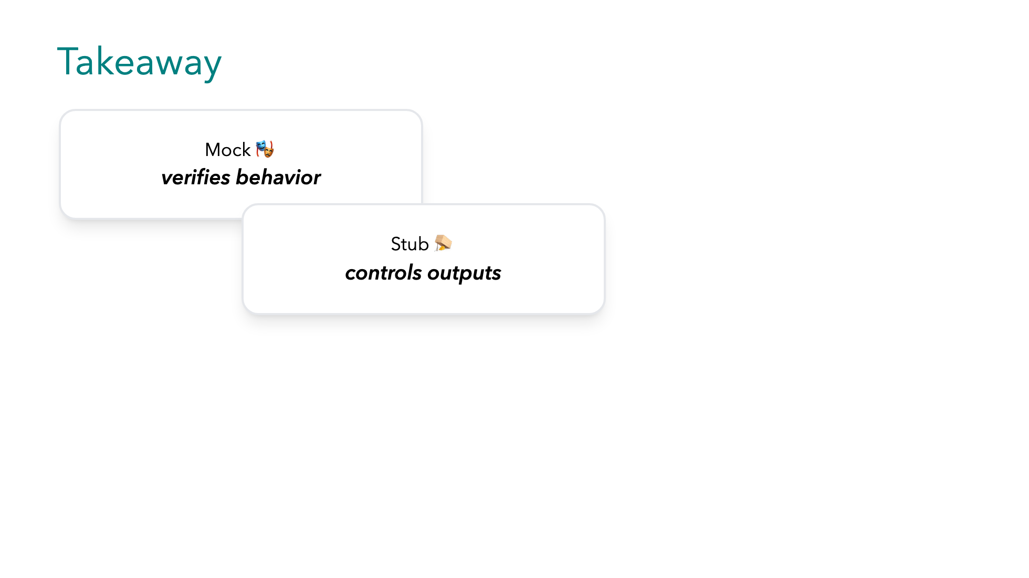
Notes:
This brings us to the takeaways. We covered...

Slide 53
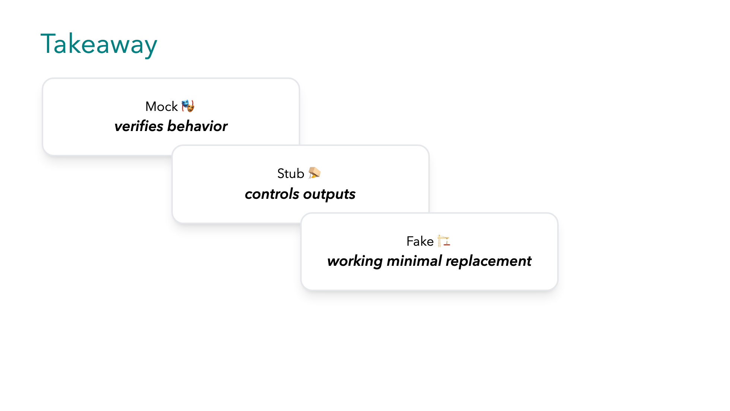
Notes:
This brings us to the takeaways. We covered...

Slide 54
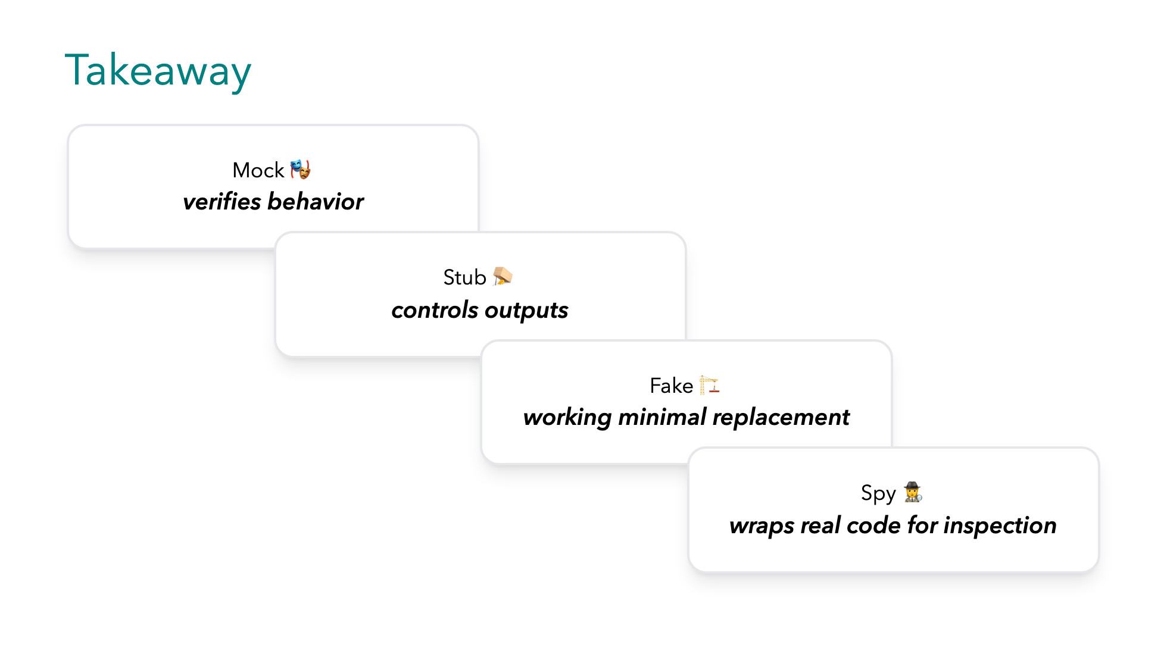
Notes:
This brings us to the takeaways. We covered...

Slide 55
Notes:
A few more things to have in mind...

Slide 56
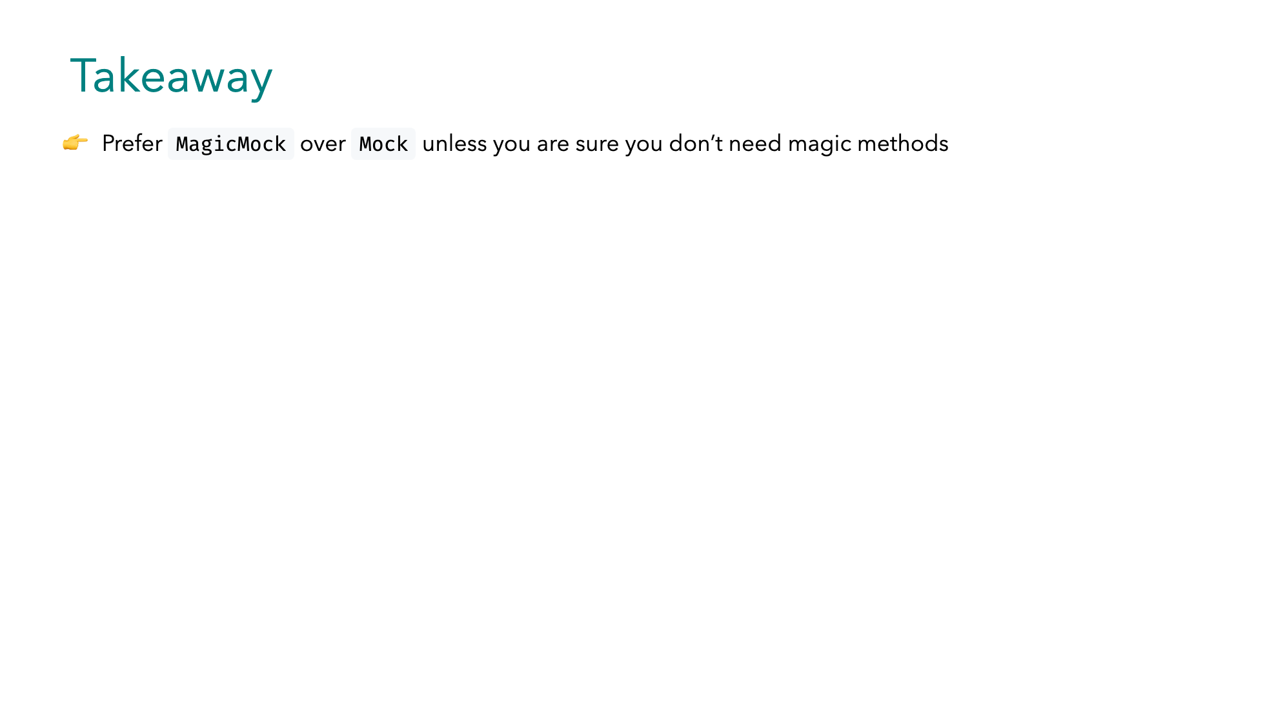
Notes:
A few more things to have in mind...

Slide 57
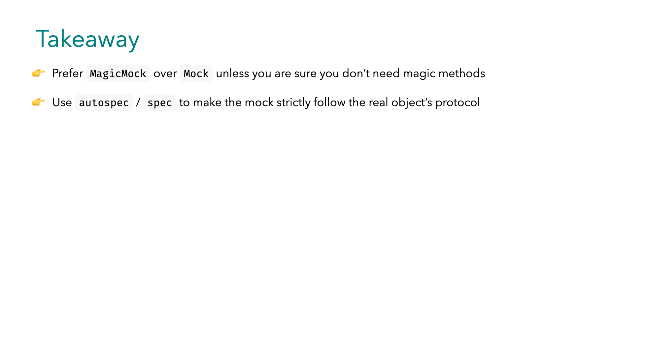
Notes:
A few more things to have in mind...

Slide 58

Notes:
A few more things to have in mind...

Slide 59

Notes:
A few more things to have in mind...

Slide 60

Notes:
A few more things to have in mind...

Slide 61

Notes:
Thank you very much!

